Slide 1

WHY come to CCSU for Your
MSN degree ?

Slide 2
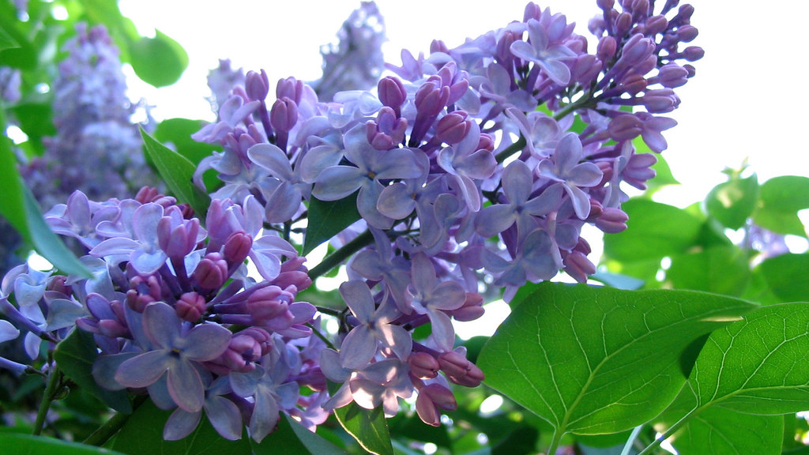
MSN: Hospice & Palliative Care
The MSN program is offered through an innovative, online format.
Accredited from American Association of Colleges of Nursing Essentials for Masters Education Nursing.
We have supportive and caring faculty.
Students come from diverse clinical backgrounds and experiences that opens one's mind to different perspectives, providing a more holistic experience.
A collaborative learning environment.
This Photo by Unknown author is licensed under CC BY-SA-NC.

Slide 3
Full time faculty who are active in clinical practice…
The faculty are RNs who are active in clinical practice. Because we also teach in the Nursing Department full time, we have experienced the challenges of juggling many roles.
We are committed to working with you and will be flexible about coursework deadlines whenever necessary as much as we can
We appreciate that many of you have challenging work-school-family responsibilities

Slide 4
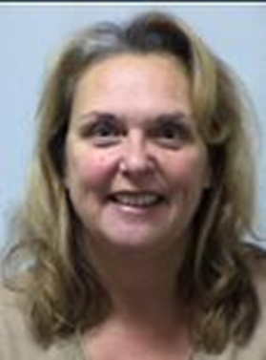
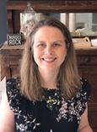
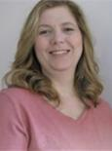
Meet our Faculty
 | Dr. Christine Kirk has 47 years of direct client care in the emergency department. Has had experience as a hospital wide resource nurse, unit manager of an endoscopy department, and preceptor of newly hired nurses in the emergency department setting. CCSU faculty since 2012 in the roles of clinical instructor, lab coordinator, and classroom faculty.
 | Dr. Tamara Holland has been working at CCSU since 2012, initially working as a clinical faculty and now as a full-time faculty member. Her background is in Women's Health/Nurse Midwifery. She is passionate about empathic care, nursing simulation, and healthcare inequities. She currently teaches NRSE 505—Comparative Domestic Delivery Systems and Informatics. Her dissertation focused on fostering the art of nursing with the utilization of technology, specifically looking at the strategies and barriers to weaving empathy into nursing simulation.
 | Dr Catherine Thomas teaches NRSE 496 Synthesis course which is the course where students employ of the concepts and knowledge that they have learned in the RN-courses to design a project proposal. This course brings all of the learning to life! Dr Thomas has a clinical background in acute care that spans several specialties (cardiac, medical and critical care) and advanced practice roles, and currently practices in the community setting as a camp nurse each summer.

Slide 5
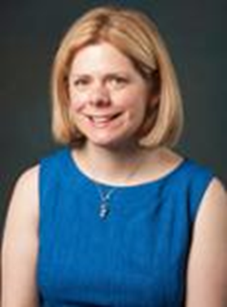
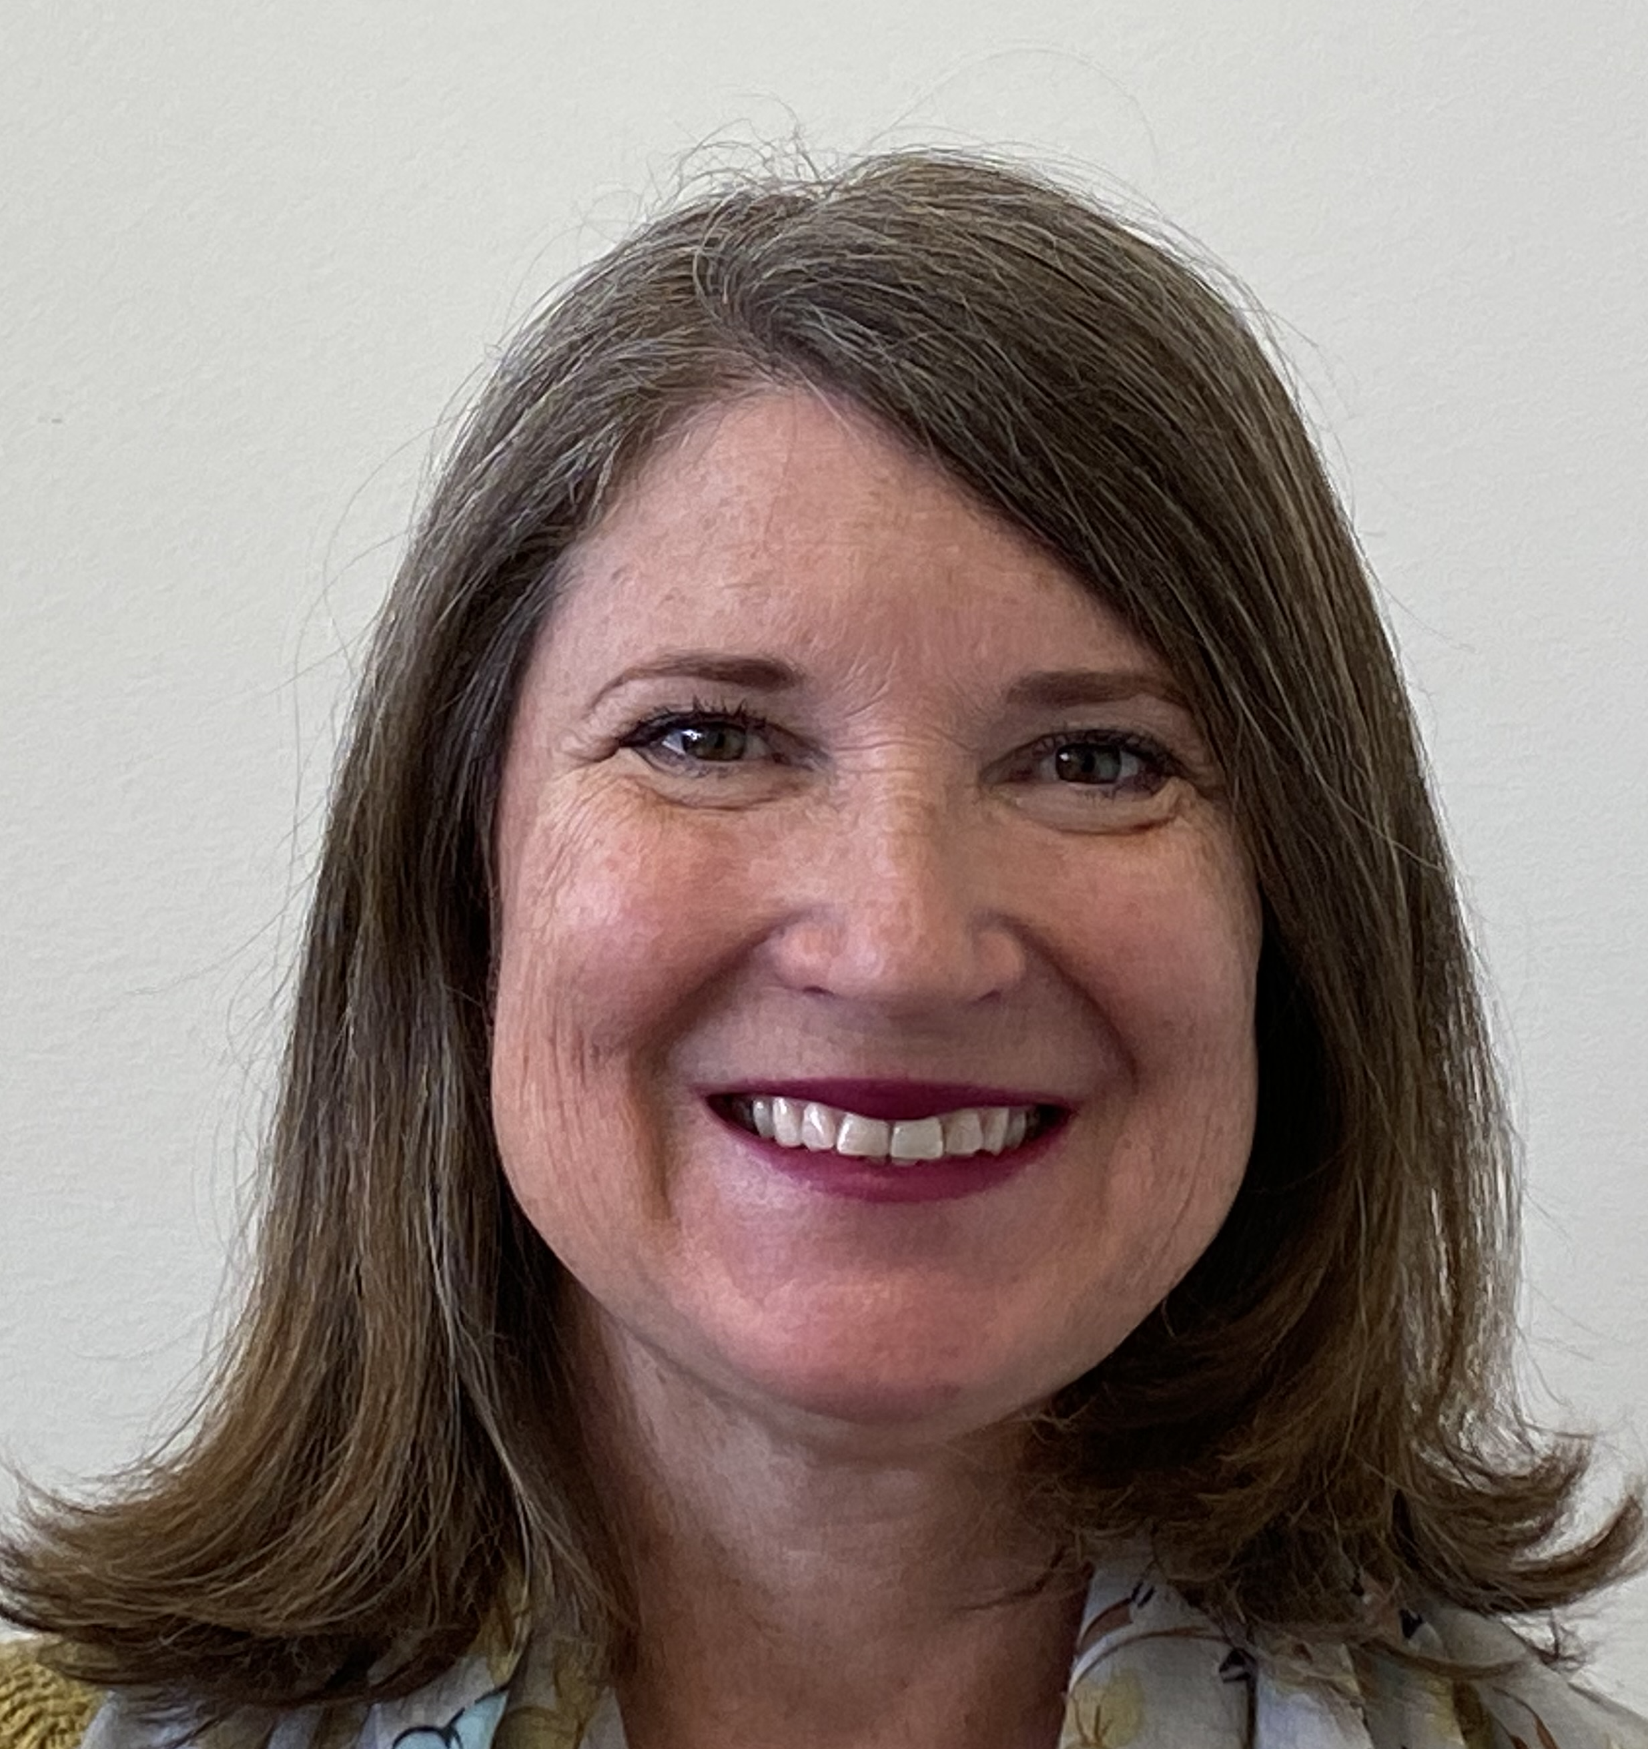
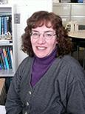
Meet our Faculty
 | Dr. Michele McKelvey has been teaching at CCSU since 2015. She teaches in the RN to BSN, BSN and MSN programs at CCUS. She has taught Maternal/Newborn Nursing, Nursing Research, Nursing Theory, Capstone, Maternity clinical and Community Health clinical. Dr. McKelvey is a practicing Registered Nurse in Maternity, Labor/Delivery and the Neonatal Intensive Care.
 | Dr. Jacqueline Cantor joined CCSU in the Fall of 2021. She teaches BSN psychiatric mental health nursing, clinical practicums and teaches for the MSN palliative and hospice care program. She obtained her BSN and MSN from the University of Connecticut and recently completed her DNP from Capella University. She is also a Psychiatric Mental Health APRN in clinical practice for over 23 years. She treats patient’s mental illnesses but as importantly teaches and promotes mental health and wellness, self-care, and self-compassion to patients, herself, nursing students, and health professionals. She is a member of Sigma Theta Tau International, Omega Gamma Chapter.
 | Dr. Meg Levvis is a nurse as well as a bioethics consultant. Her research interests include ethical issues connected to biomedical research, neonatology, gerontology, hospice and palliative care, and human trafficking and has presented and published locally, nationally, and internationally.

Slide 6
Support, support, support!!!
Upon enrollment in the first nursing course, CCSU will purchase a one-year subscription to PERRLA, an excellent source to assist with scholarly writing.
Access to the writing center!! A wonderful source of support! https://youtu.be/VY3qbogh2Qw
Childcare available for when you are on campus! We are a family friendly campus https://www.ccsu.edu/familyresources/
Paul L. Jones Foundation Scholarship. Students will be notified via CCSU email when application opens each fall. Requires GPA of 3.0 + and be a resident of state of CT.
Many of CCSU Nursing Programs Practice Based Clinical Partners & CCNE accreditation body share scholarships with us throughout the year - those notifications will be shared with students via email.

Slide 7
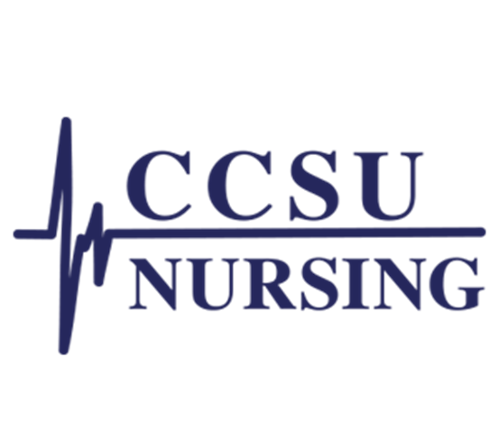
Program feedback from our students/graduates:
Thank you for a great semester and I really enjoyed the class content.
Thank you for an awesome course I have learned so much.
Thank you so much. Without you up-beat lecture and positive outlook this semester would be a tough one.
Thank you so much for being so understanding, it has helped decrease my stress level about this course
Thank you so much for inspiring me to become a great nurse. Thank you for being there every step of the way. You have truly made a difference in my life

