Slide 1
Information Session for Initial Teacher Certification

Slide 2
2021-2022 Steps and Information on Obtaining CT Initial Teacher Certification
| 2

Slide 3
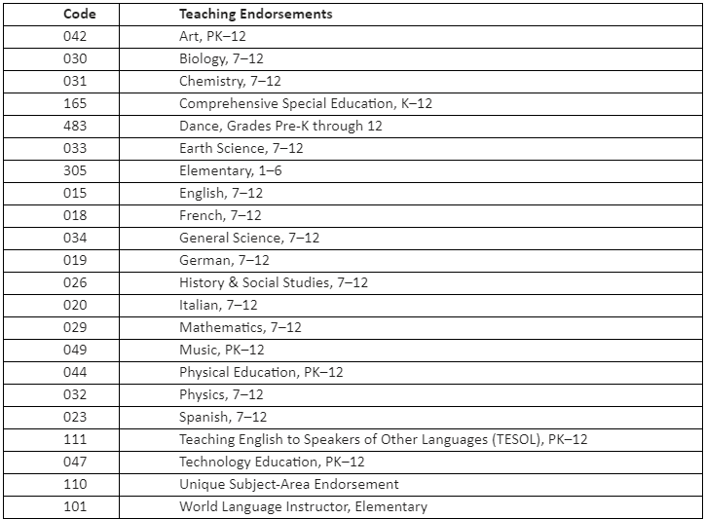
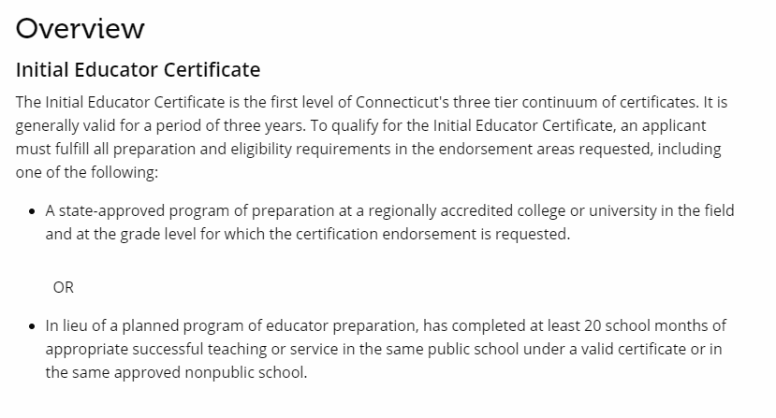
Initial Teacher Certification
*Endorsement Codes
| 3

Slide 4
I. Create a Connecticut Educator Certification System (CECS) Account*
*If you do not already have a CECS account
Make note of your EIN (Educator Identification Number) number
•Go to www.ct.gov/sde/cert, select the red button (CECS) and follow the directions to create your account.
•Be sure to make note of your EIN (Educator Identification Number) number.
•You will receive an email with a confirmation of your account. You will need to email a copy of your confirmation to SEPS_ProfProg@CCSU.edu
The First 6-Sided Extended Reality Lab in the Northeast!
| 4

Slide 5
II. Submit an On-Line Application for Certification through CECS* *Do NOT apply to the SDE for certification until your Fall or Winter semester grades are posted
Once you have established your CECS account you may now apply for your certification
Log into your CECS account
Select Apply On-Line
Complete the Application
You will be charged a $50.00 application fee. When your application has been reviewed and the CCSU recommendation has been confirmed, you will be notified to pay the remaining fees. (Balance of $150.00)
Your certificate will be posted to your CECS account once approved.
| 5

Slide 6
III. Submit information required by CCSU for Certification Recommendation
•Forward the confirmation email of your account to SEPS_ProfProg@CCSU.edu. We are unable to process your recommendation without this confirmation.
•Complete the required information electronically through this online form – https://bit.ly/3wGbwVW
The First 6-Sided Extended Reality Lab in the Northeast!
| 6

Slide 7
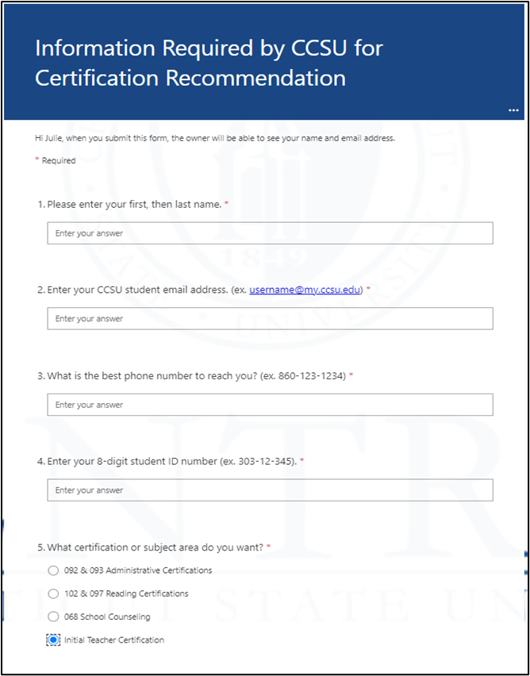
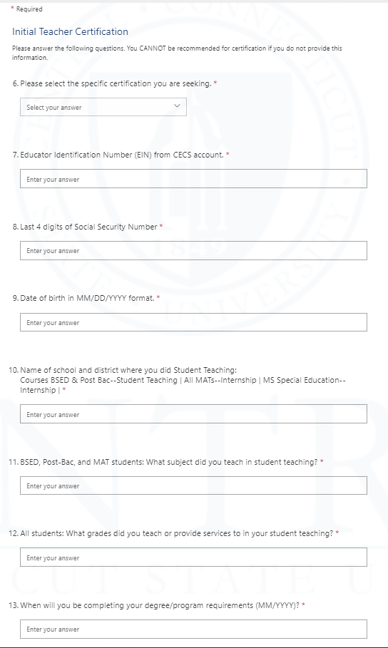
III. Required Information to be Submitted to CCSU for Certification Recommendation
The First 6-Sided Extended Reality Lab in the Northeast!
| 7

Slide 8
IV. Complete EdTPA
All BSED, Post-Bac, MAT, and MS Special Education Teacher Candidates must have a nationally scored edTPA assessment in order to qualify for certification.
Contact Dr. Carol Ciotto if you have questions at ciottocaj@ccsu.edu
The First 6-Sided Extended Reality Lab in the Northeast!
| 8

Slide 9
V. Pass All Assessment(s) Required for Educator Certification
Candidates must have all tests passed before a certification recommendation will be made.
•To review here are the assessments required to obtain prior to applying for certification -
Basic Skills Test
Praxis II – Content Knowledge
Foundations of Reading (Elementary, Comprehensive Special Education)
Reading Specialist Test (Remedial Reading/ Reading and Language Arts Consultant)
ACTFIL
Connecticut Administrator Test (CAT) - Those seeking administrator certification
The First 6-Sided Extended Reality Lab in the Northeast!
| 9

Slide 10
VI. Submit Transcripts to SDE
SENT TO YOU, THEN TO SDE *Write EIN on each envelope | SENT DIRECTLY TO SDE *Include EIN in transcript request
CT State Department of Education Bureau of Educator Standards and Certification P.O. Box 150471 Hartford, CT 06115 – 0471 | CT State Department of Education Bureau of Educator Standards and Certification P.O. Box 150471 Hartford, CT 06115 – 0471
| 10

Slide 11
VII. Complete and submit the ED 170A Form
Complete the highlighted sections of the ED 170A form
Once completed email ED 170A form to SEPS_ProfProg@CCSU.edu. (*This is the institutional recommendation)
CCSU SEPS will complete the sections that are not highlighted.
CCSU SEPS will verify all certification courses are completed
CCSU SEPS will batch forward completed institutional recommendation forms (ED 170A) to the Bureau of Certification by the 15th of every month.
The First 6-Sided Extended Reality Lab in the Northeast!
| 11

Slide 12
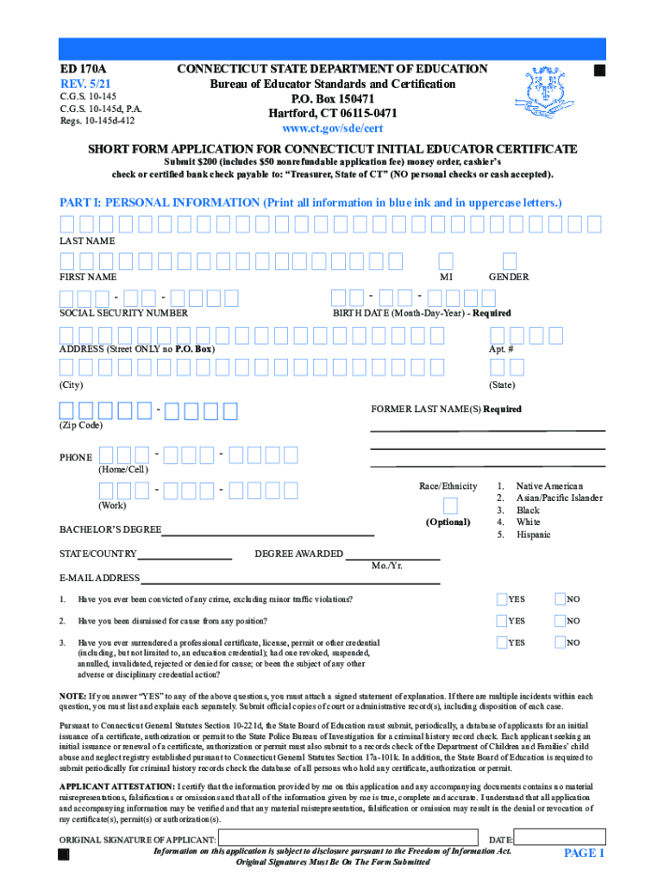
VII. ED 170A Form
The First 6-Sided Extended Reality Lab in the Northeast!
| 12

Slide 13
VIII. SDE Issues Certificate
Once all requirements have been met, the CSDE your certificate will be posted to your CECS account.
The First 6-Sided Extended Reality Lab in the Northeast!
| 13

Slide 14
Additional Information
Verification Letters
Although some school districts require you to have your teaching certificate before making a job offer, some will consider you for a position pending certification, which would be based on a verification letter from CCSU.
The verification letter from CCSU confirms you have completed your Professional Program and/or degree, if applicable.
It will also state that we have a record of the passing test scores for your certification area and CCSU is ready to sign your certification application.
The First 6-Sided Extended Reality Lab in the Northeast!
| 14

Slide 15
CT Teacher Certification Timeline
Standard processing of certification applications is 6-8 weeks, and 10-12 weeks during peak months, from the original date of submission.
Please note: The total cost of an Initial educator certificate is $200.00, including the $50 nonrefundable review fee. The money order, cashier’s check or certified bank check should be made payable to “Treasurer, State of Connecticut.” Personal checks cannot be accepted.
| 15

Slide 16
| 16

Slide 17
| 17

