Slide 1
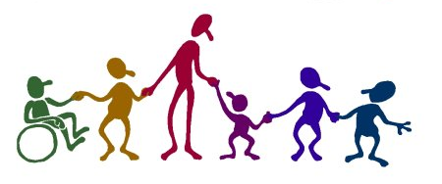
Sponsored by the Faculty Senate Diversity Committee
Diversity in Our Lives:
An Introduction
By Dr. Marisa Mealy

Slide 2
What is Diversity?
“Noticeable heterogeneity”
“A diversity of possibilities“
“A mosaic of individuals and groups with varying backgrounds, experiences, styles, perceptions, values and beliefs.”

Slide 3
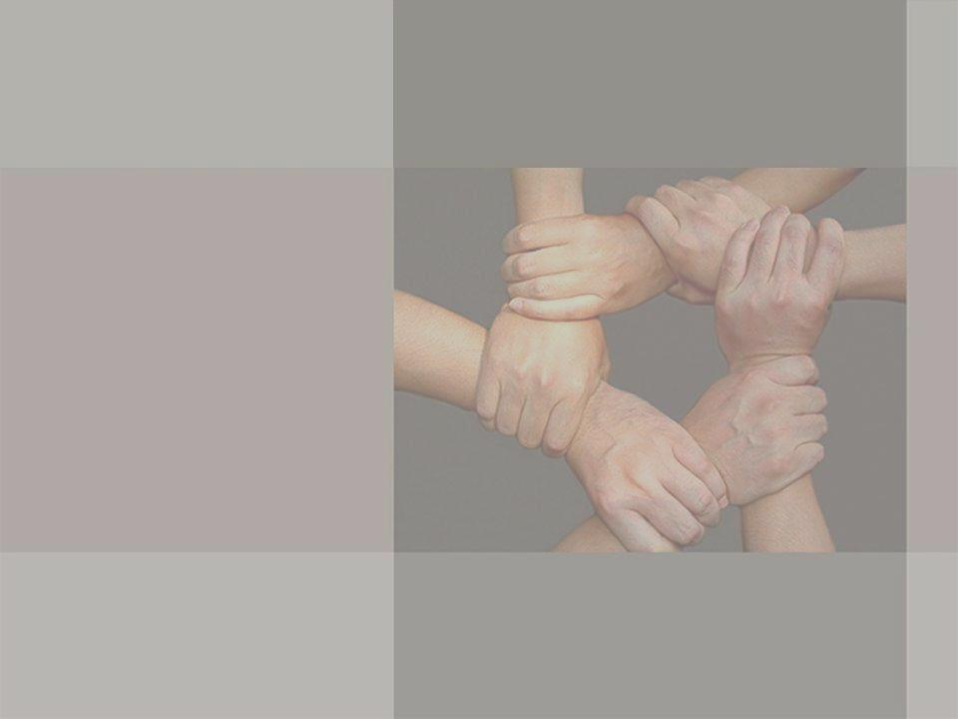
Diversity is NOT:
Diversity is NOT mouthing politically correct statements about how we can all just get along and that some of my best friends are ___________ (fill in the blank).
Diversity is NOT stating that because I’m not (gay, Black, female, physically challenged, from a poor neighborhood) I can’t understand or study or work in coalition with those that are.
Diversity is NOT saying you can be ____________ if you are quiet and don’t rub my face in it.
Most importantly, diversity is NOT being so-called “COLORBLIND”. That’s a myth. No one is colorblind.
Refusing to acknowledge or face differences is not diversity; it’s avoidance.
-Celeste Atkins, Sociology, University of Southern California

Slide 4
How can we understand diversity?
True diversity is embracing difference and understanding that there is NEVER just one true way to do anything.
True diversity involves accepting that we all have preconceptions, stereotypes and misperceptions about those who are different from us.
It involves understanding that difference can be frightening, but it can also lead to growth.
And, most importantly, it involves dialogue in a nonconfrontational, safe setting where we can ask those questions we often feel dumb or possibly offensive… but that we really need the answers to in order to get past our misconceptions.
-Celeste Atkins, Sociology, University of Southern California

Slide 5
It really isn’t much of an issue any more – is it?
Why should you care?

Slide 6
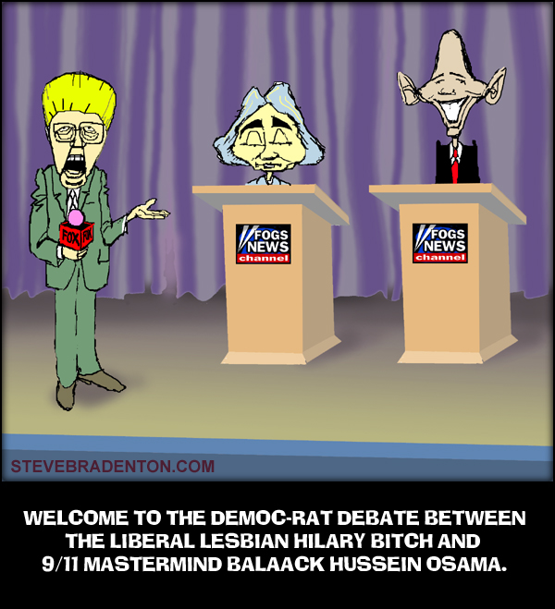

Slide 7
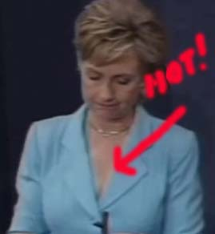
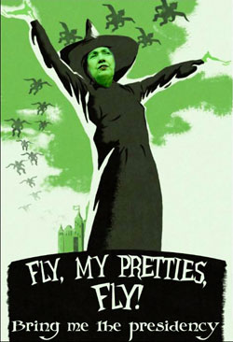
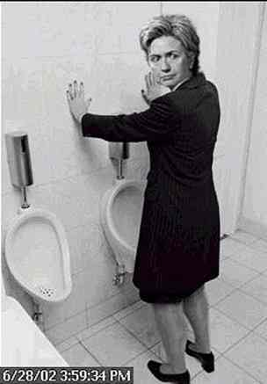
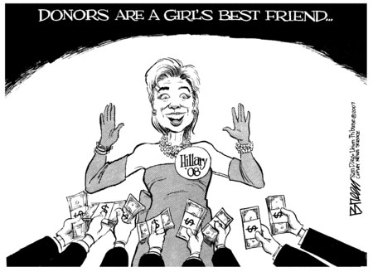
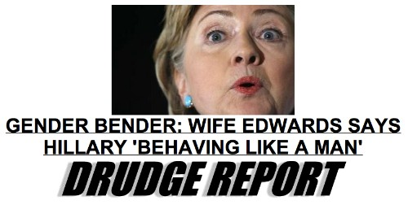
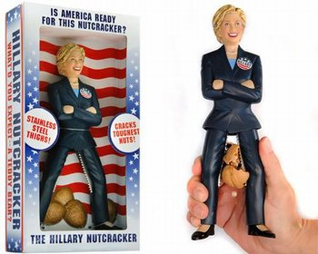
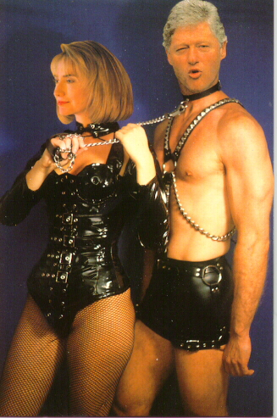
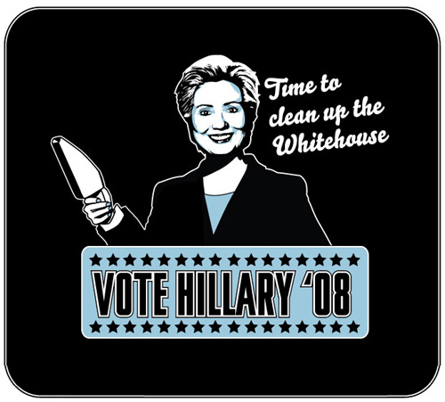
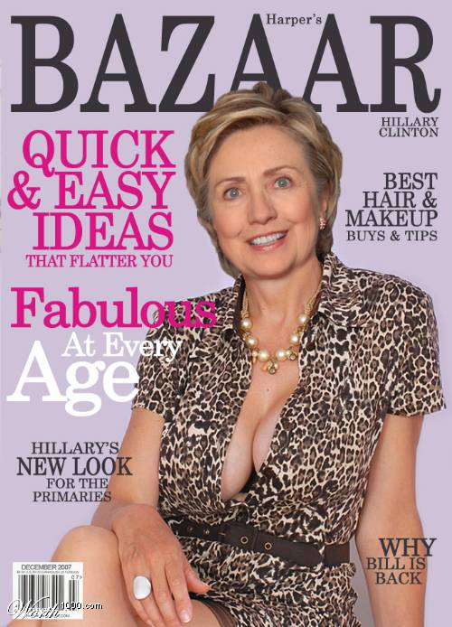
What’s gender got to do with it?
On his MSNBC show, Tucker Carlson says, "There's just something about [Hillary] that feels castrating, overbearing and scary"

Slide 8
Even the CCSU Recorder weigh’s in…
Proper Theme Song for Hillary Clinton: “She’s a very kinky girl” when it comes to harnessing power. Being addicted to the political process and achieving the presidency is, to her, one of the sexiest things possible.
Though not Barack Obama’s official campaign theme song, Obama bumped [Jay-Z, “99 Problems”] after beating Hillary in Iowa. “I got 99 problems but a bitch ain’t one” didn’t go over so well with Hillary supporters, but it showed balls on Obama’s part.

Slide 9
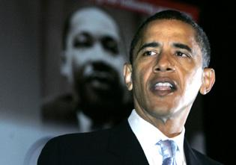
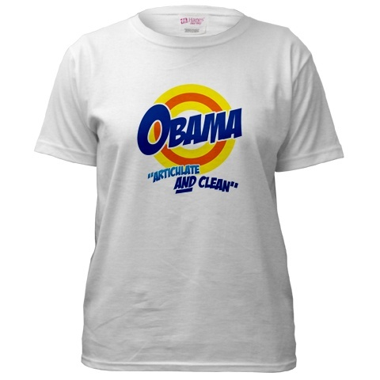
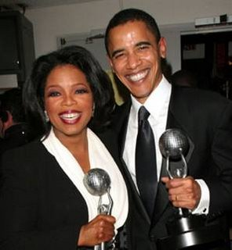
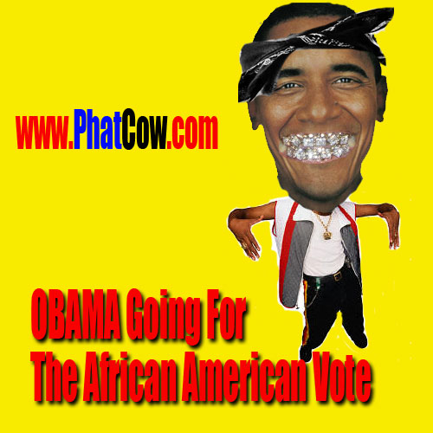
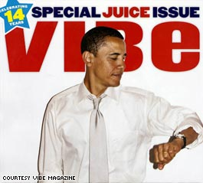
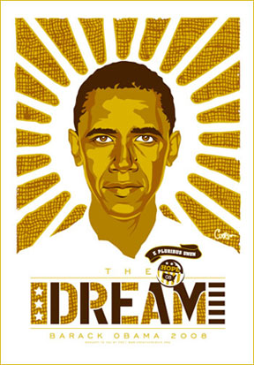
Is Obama black enough?
Arial Font Family

Slide 10

The Bradley Effect???
When very high numbers of white voters tell pollsters in advance of an election that they are either genuinely undecided, or likely to vote for the non-white candidate, but then exhibit a different behavior when actually casting their ballots.
  Is this because voters say they are going to vote for the non-white individual, but when push came to shove, change their minds?
1982 – Tom Bradley – California
1983 – Harold Washington – Chicago
1989 – David Dinkins – New York
1989 - Doug Wilder in Virginia
1990 - Harvey Gantt in North Carolina
2008 - Barack Obama in New Hampshire

Slide 11


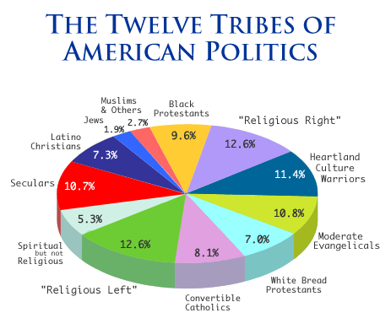

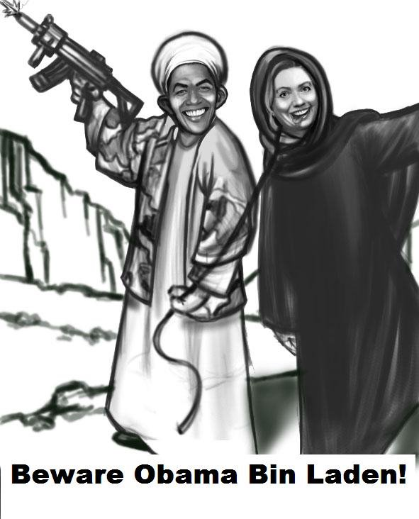

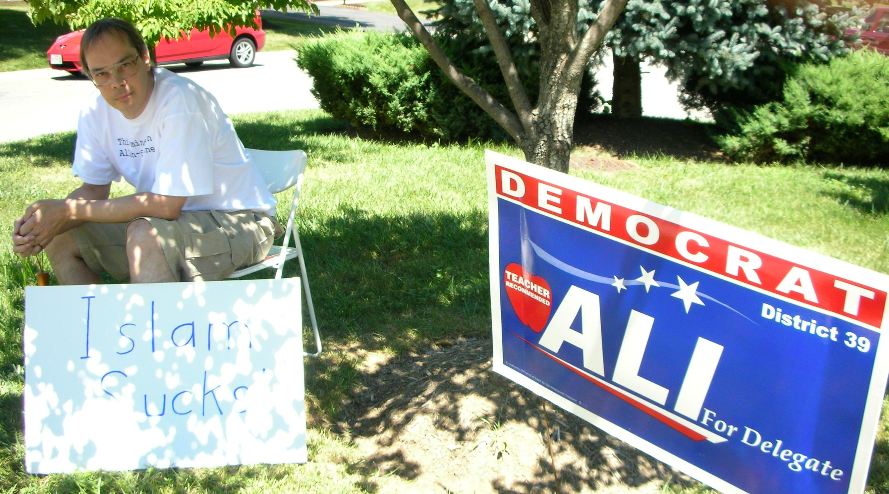
The Politics of Faith in America

Slide 12

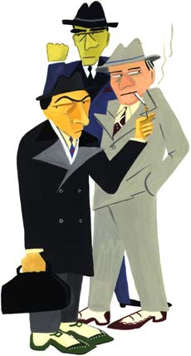
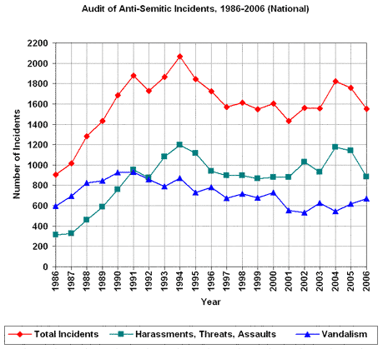
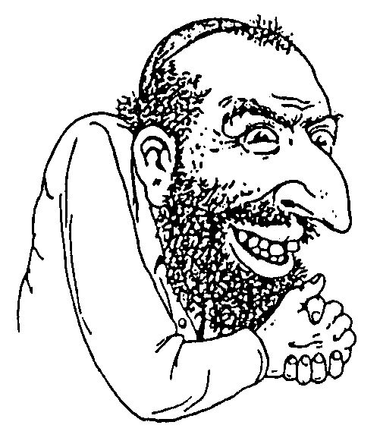

According to the ADL
The ADL counted a total of 1,554 anti-Semitic incidents across the United States in 2006, representing a 12 percent decline from 1,757 reported in 2005.

Slide 13

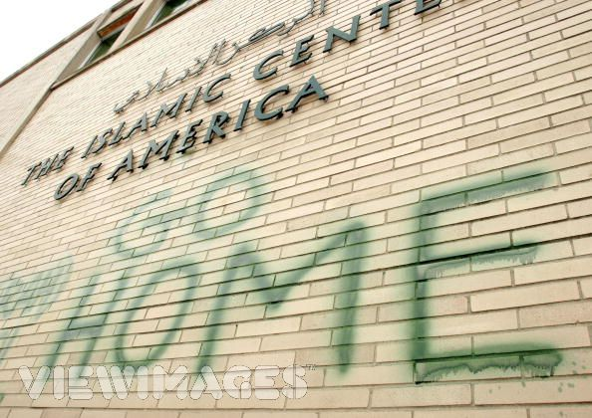


According to the USA TODAY/Gallup Poll
39% of Americans admitted some prejudice against Muslims.
39% of Americans favored requiring Muslims - including U.S. citizens - to carry a special ID to prevent “terrorist attacks in the United States."
33% of Americans thought U.S. Muslims were sympathetic to al-Qaeda.
22% wouldn’t want Muslims as neighbors.

Slide 14
Yeah, but those are national level issues...

Slide 15
Hartford Courant Headlines in 2008
Gender
  Surveys Show Scope of Dating Abuse Problem
  Dating Violence Triggers Activism
  Military Honors For Rapists
  The Dilemma of Gender and Race
  Loophole Protects Man in Sex Case
Ethnicity and Race
  Trial starts for radio race discrimination case
  A Tonic for the Lingering Pain Of Racism
  Spin Falsely Characterizes Hispanic Voters’ Bias
Immigration
  Immigrants Denied Hearing
  Hate Speech Cited in Immigration Debate
Other Minority
  Minority Borrowers Face Higher-Cost Mortgages
  Ministers, minority lawmakers oppose three-strikes proposals

Slide 16
Yeah, it may be local, but it still doesn’t affect me…
So, I’m not going to make myself miserable thinking about it.

Slide 17
A snapshot of CCSU 2006-2007
Gender
  The Recorder’s Opinion Editor describes rape in a positive light
  A 'cartoon' featuring a 14 year old Latina girl being locked in a closet and urinated on
Race Relations
  An African-American professor received documents with pictures degrading of blacks.
  NIGGER scrawled across a flyer
  A black stick figure being hanged found in a dorm

Slide 18
“Rape only hurts if you fight it”
Excerpts from the Recorder Feb 7, 2007
Rape is a magical experience that benefits society as a whole.
Rape’s advantages can very much be seen today. Take ugly women, for example. If it weren’t for rape, how would they ever know the joys of intercourse with a man who isn’t drunk?
With rape, prisoners… merely need worry about treating their rapist with enough love and respect to earn a quick reach-around.
  video

Slide 19
Reported Rapes in Connecticut
 | # of rapes
2001 | 639
2002 | 740
2003 | 698
2004 | 755
2005 | 712
2006 | 636

Slide 20
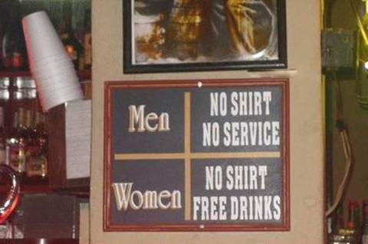
But those are extreme acts…
by really crazy people, right?

Slide 21
Reality?
A college survey conducted by the National Victim Center reported that one in four college women have been raped or suffered attempted rape (Bureau of Justice, 1992).
In another college survey, half of the college men reported that they engaged in some form of sexual aggression on a date (Bureau of Justice, 1995).

Slide 22
News from February 1, 2008:
According to the Hartford-based Institute for Community Research, of 428 high school students polled:
  11% experienced teen dating abuse.
  45% witnessed teen dating violence.
In Fairfield County, a survey of 458 teens by the Center for Youth Leadership in Norwalk found:
  75% believe verbal abuse is a serious problem in dating relationships.
  42% do not see their friends frequently because of a partner's jealousy.
  26% had been punched, kicked or slapped by their partner during the past 12 months.
  21% have had their partner threaten to hurt them (or others) if they end their relationship.
  16 % have had their partner force them into sex during the past 12 months.

Slide 23
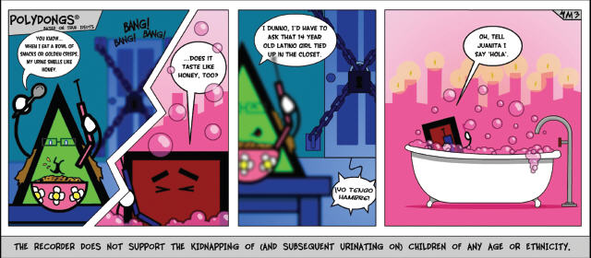
Also from the Recorder
  video

Slide 24
“Lighten up, it’s just a cartoon.”
Categories of sexual abuse include child pornography, child prostitution, exhibitionism, incest, molestation, pedophilia, rape, and statutory rape.
  1 in 4 girls is sexually abused before the age of 18.
  1 in 6 boys is sexually abused before the age of 18.
  1 in 5 children are solicited sexually while on the internet.
Nearly 70% of all reported sexual assaults (including assaults on adults) occur to children ages 17 and under.
An estimated 39 million survivors of childhood sexual abuse exist in America today.
Just curious: Since when was kidnapping, sexual assault, urinating on a minor, and racism a good topic for a cartoon?

Slide 25
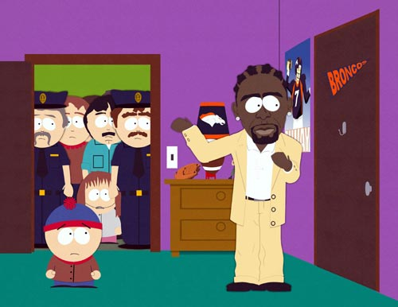
“It’s only the recorder…”
R Kelly was charged with 21 counts of child pornography and sex with an underage girl in 2002, after a tape emerged showing someone that looks like Kelly having sex with and peeing on a 14-year-old girl. The trial is set for 2008.
And this is funny?

Slide 26
It’s all black and white
An African-American professor received documents with pictures of black teachers speaking in black minstrel dialect…their hairstyles are mocked and one figure refers to “guilt-ridden honky liberals”.
NIGGER scrawled across a flyer for a rally promoting an improvement in race relations. It was then mailed to a professor in the African Studies program.
A drawing clearly depicting a black stick figure being hanged found in Barrows Hall.

Slide 27
“These are isolated incidents”
Yet, a study showed that:
64 percent of white respondents said they had never faced discrimination…
While only 14 percent of blacks
and 9 percent of Hispanics
could say the same.

Slide 28

In 2004 there were 116 hate crimes in Connecticut…
 | Race | Religion | Sexual Orientation | Ethnicity | Disability | Total
2005 | 52 | 21 | 8 | 10 | 4 | 95
2006 | 56 | 30 | 29 | 14 | 2 | 131

Slide 29
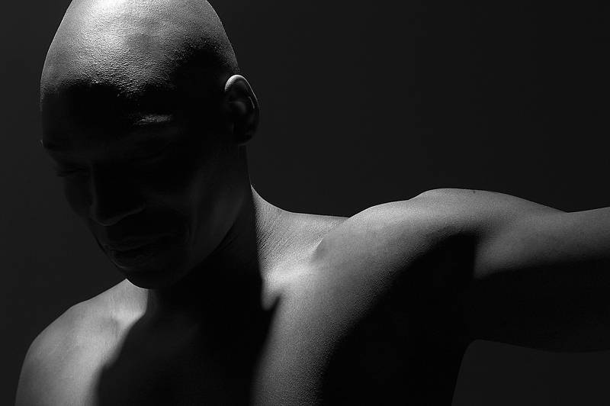

Excerpts from Senate Diversity Committee Report: 2006-2007
CCSU is the only institution of higher education in Connecticut without a single Latino above the level of assistant dean.
The African American Caucus has documented dozens of instances of prejudice and discrimination against Black faculty and staff, including racist messages and E-mails, unfair treatment, and discrimination in promotion and hiring.
Members of our Gay/Lesbian and Bisexual community have been the targets of hate speech and aggressive messages, some in public forum like the university E-mail list-serve or “The Recorder.”

Slide 30
It’s hard to believe that these things happen here on campus.
In fact, it’s really horrible.
But I really don’t have the time to do anything about it.

Slide 31
But, at least, I’m not prejudiced
Implicit Associations Test

Slide 32
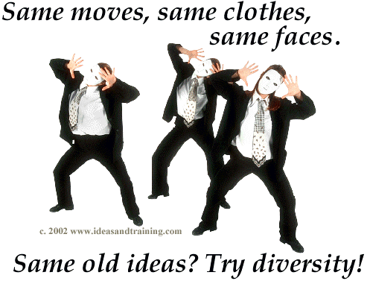
Is this a snapshot of CCSU in
2008?

Slide 33




Or is this CCSU in 2008??
YOU decide!!!
CC SU

Slide 34


Slide 35
When does it become your concern?
What makes it worth the effort?

Slide 36

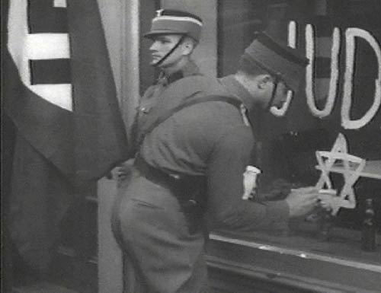

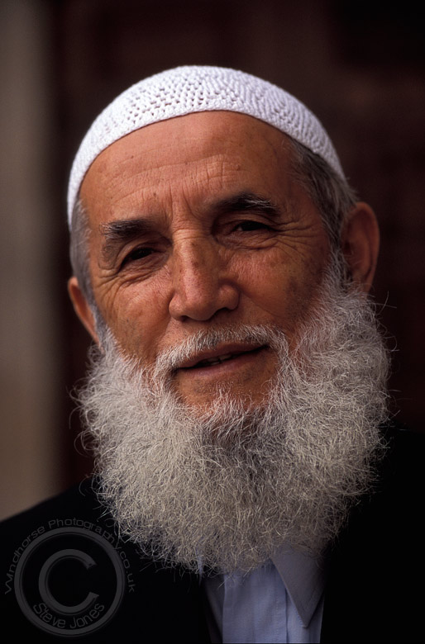

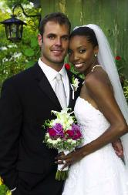
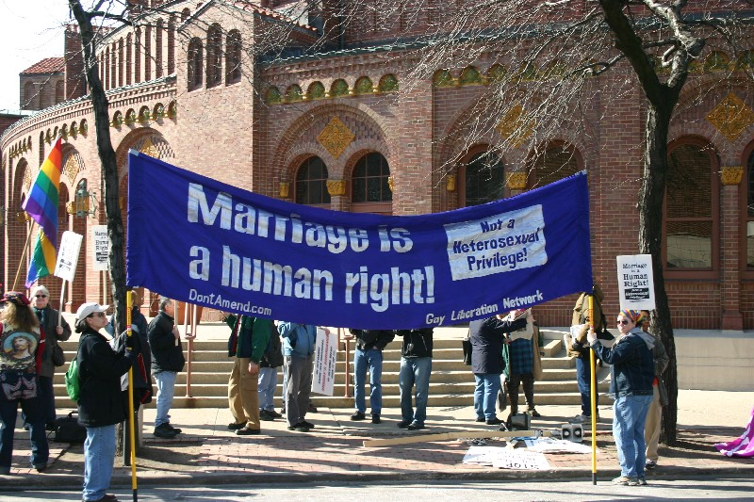
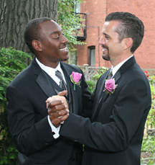
HATE PARALLELS HATE!!!
June 12, 2007, marked the 40th anniversary of Loving v. Virginia, the Supreme Court decision that ended the practice of making interracial marriages a crime.

Slide 37

Stop the Hate
HATE PARALLELS HATE

Slide 38
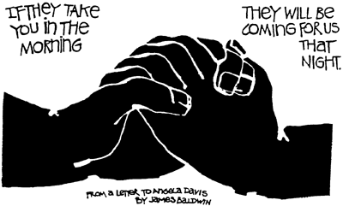
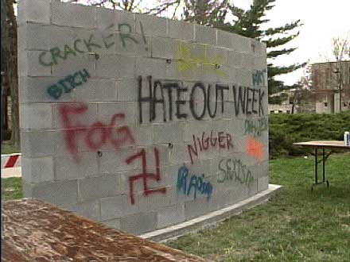

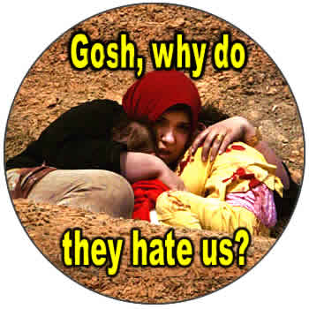
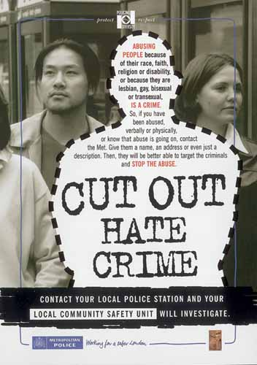

HATE PARALLELS HATE

Slide 39
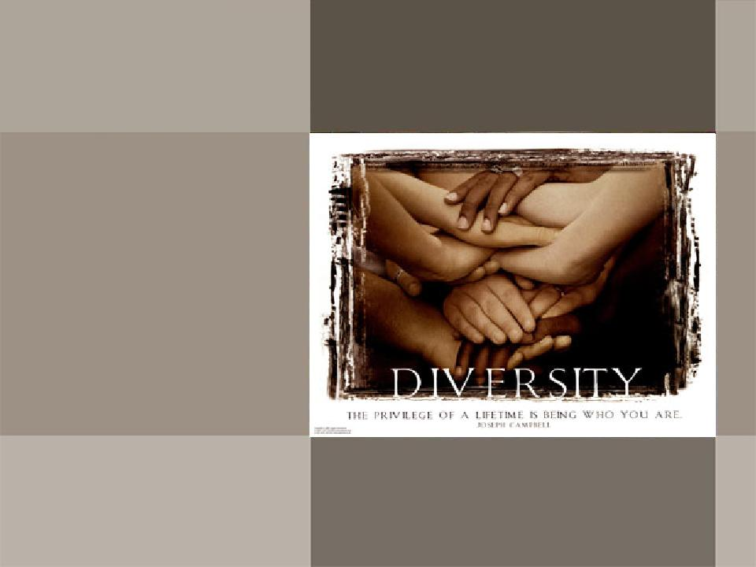


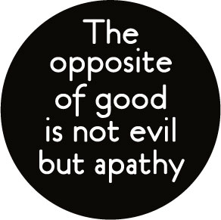

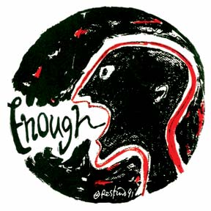
What can I do?
Start small, but think big!!!

Slide 40
Diversity is the one thing we have in common. Celebrate it every day!!!

Slide 41

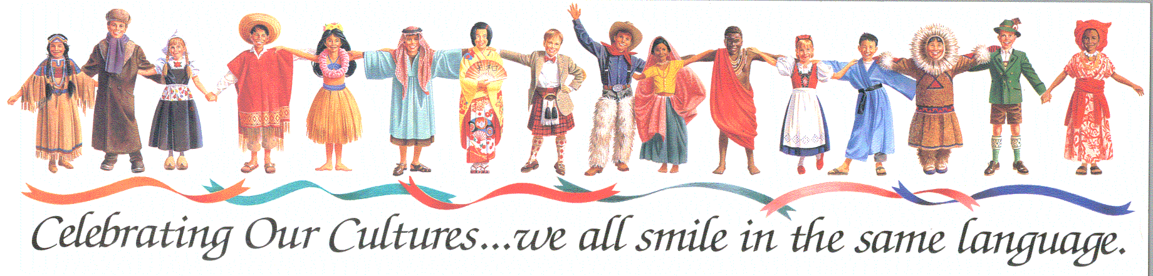

Slide 42
Exit Video

