Slide 1
Concur Expense New user interface
Quick-start user guide

Slide 2
Table of Contents
Retrieving the Approved Travel Authorization
New Expense Interface
Enter Report Header Details
Verify Travel Allowance
Adding Expenses
Adding Alerts
Verifying Receipts
Traveler Paid – Not Reimbursable
Allocating Expenses
Submitting Expenses
Request Interface
Travel Help

Slide 3
Retrieving the Approved Travel Authorization
Find the approved TA in the requests
If the TA does not show as an Active request, click view and select Approved Requests
The Total is the Amount Approved
Click the Expense action to link the TA to the Expense report

Slide 4
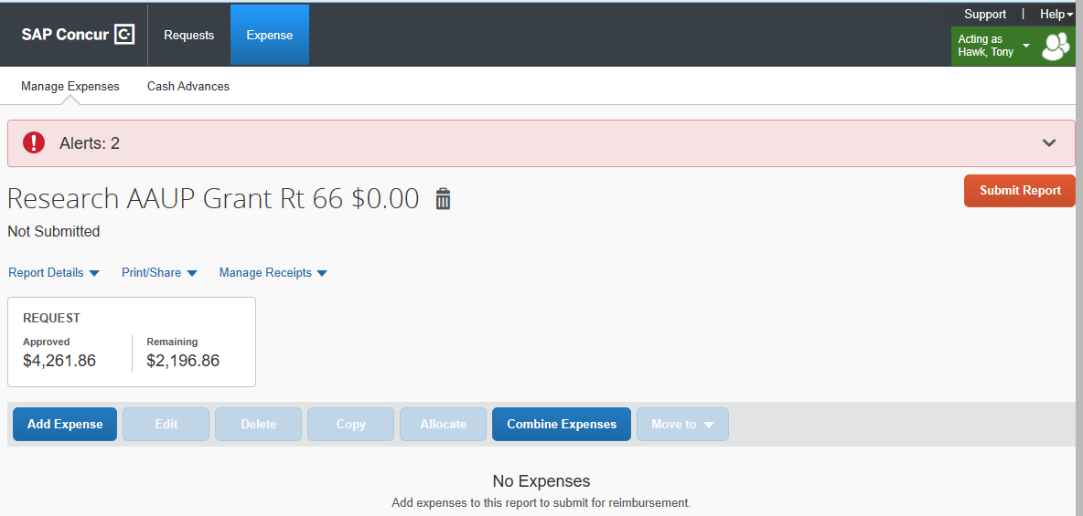
New Expense Interface
New alert feature
Click drop down, see the exceptions
Larger Buttons
Request Amount
This was total requested, not total approved. Please see request TA “Total” for approved amount
Disregard

Slide 5
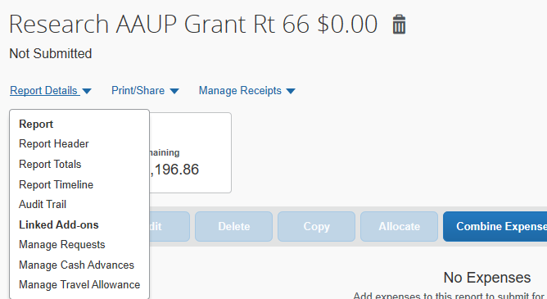
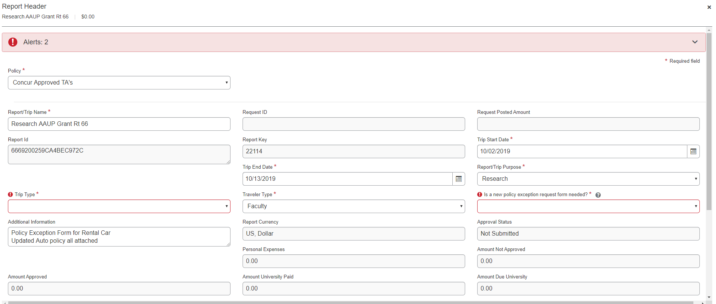
Enter Report Header Details
This automatically popped up in old interface
Will manually access in new UI
Click Report Details
Report Header
Report Header will open up full screen
Fill in everything with a red asterisk (*)
Scroll down for additional fields
Travel Allowance is itinerary/meal per diem
Click Save/Next at the bottom of Report Header

Slide 6
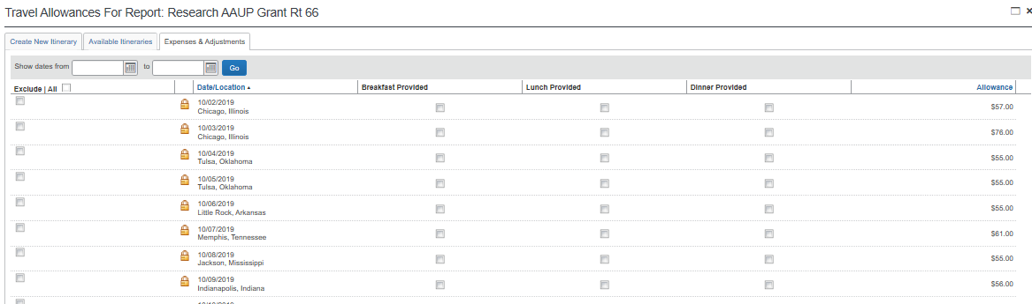
Verify Travel Allowance
Disregard
Click Travel Allowance
Manage Travel Allowance
Itinerary for trip displays
Verify for accuracy
Click Expenses & Adjustments for meal per diems
Verify and deduct any meals provided
Click Update Expenses

Slide 7
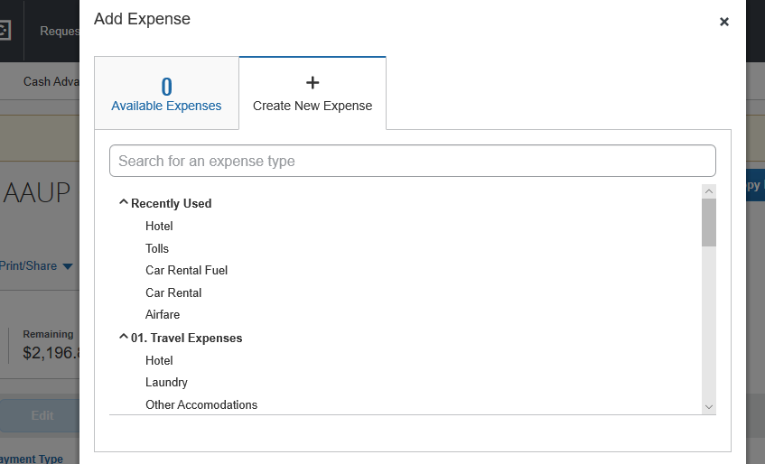
Adding Expenses
Click Add Expense
New window opens with expenses
Type or scroll up and down to find appropriate expenses
Click on desired expense
New Expense window opens full screen

Slide 8
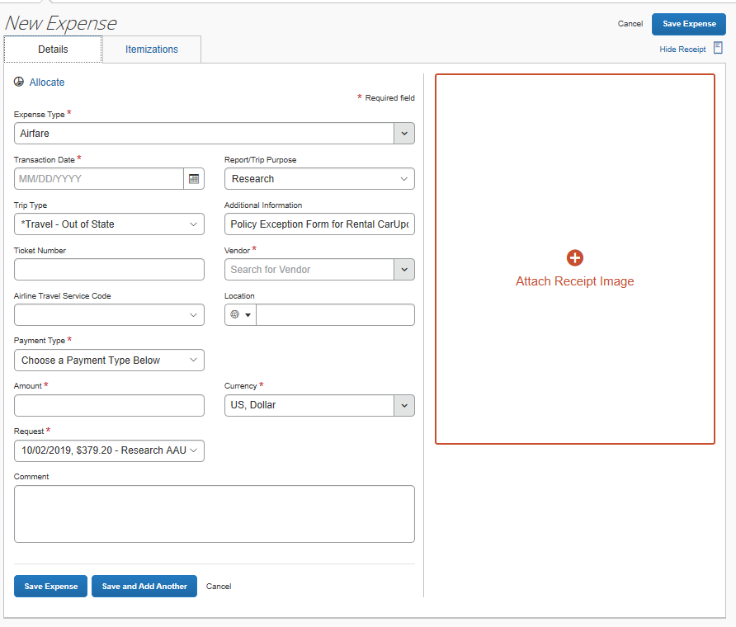
Adding Expenses
Expense entry is now full screen
Select vendor from drop down or type in
Can save expense and close or save and enter next expense
Add receipt is larger and easier to see
Can now add receipt before saving expense

Slide 9
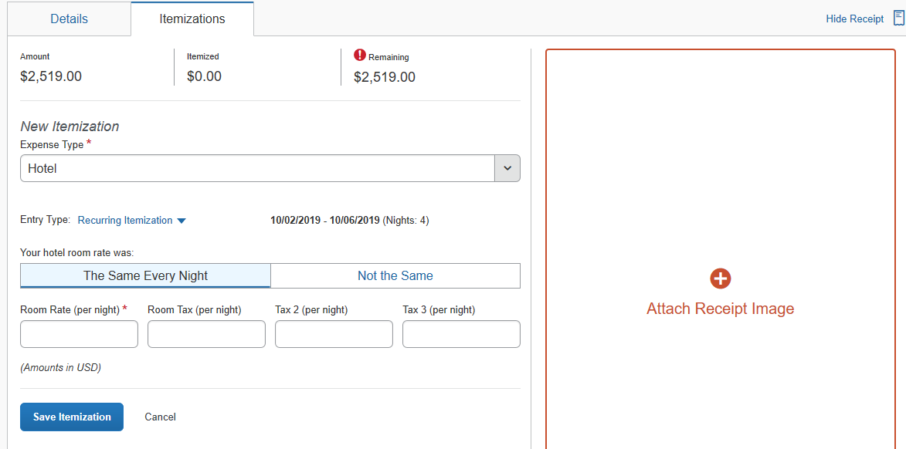
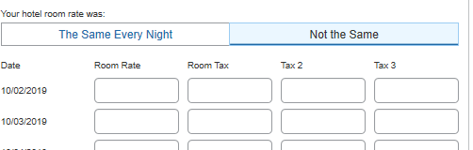
Adding Expenses
Alerts for expense entry more obvious
Hotel itemization available before saving expense
Alert will pop up when saved without itemizing
Itemization now easily allows for different room rates/taxes each night
Nightly taxes can be separated or lumped together for the night

Slide 10
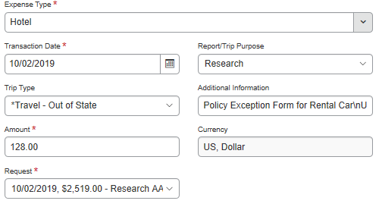
Adding Expenses, Alerts
Alerts adjust once expense is saved
Will disappear when satisfied
Click View to see alert details
Expense amount and itemization amount do not match
Hotel expense entered as $2519
Itemizations add up to $589
Adjust Hotel expense or nightly rate/taxes
Click on the expense to adjust

Slide 11
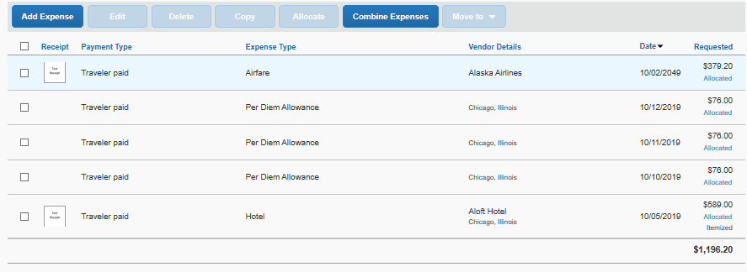
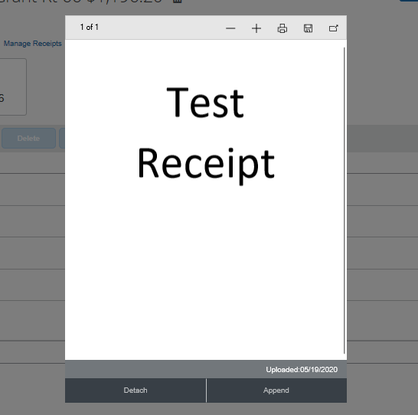
Verifying Receipts
Click on receipt icon
Receipt image will appear in front of expense list
Scroll down if necessary
Click out of the receipt box to return to expense report

Slide 12
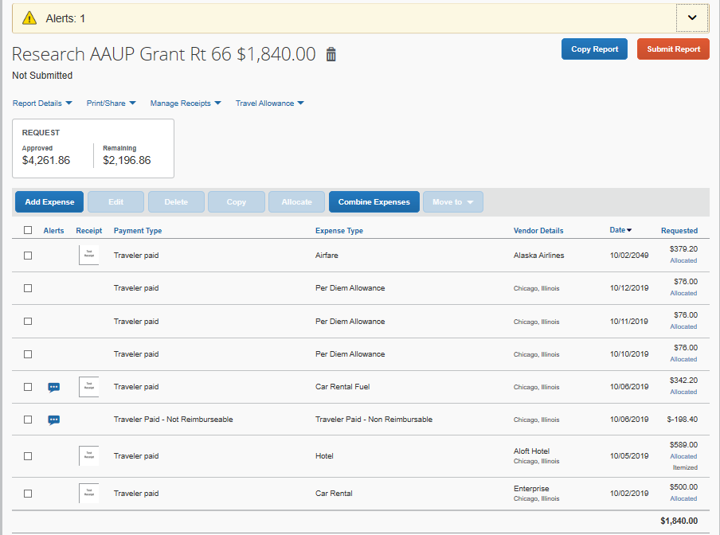
Traveler Paid – Not Reimbursable
Disregard
Use “Traveler Paid – Not Reimbursable” to bring expense report total down
Adjust total expenses to approved amount OR reduce individual expenses to align with policy limits (i.e. over limit lodging or transportation expenses)
Expense type “traveler paid – not reimbursable” does not require receipt

Slide 13
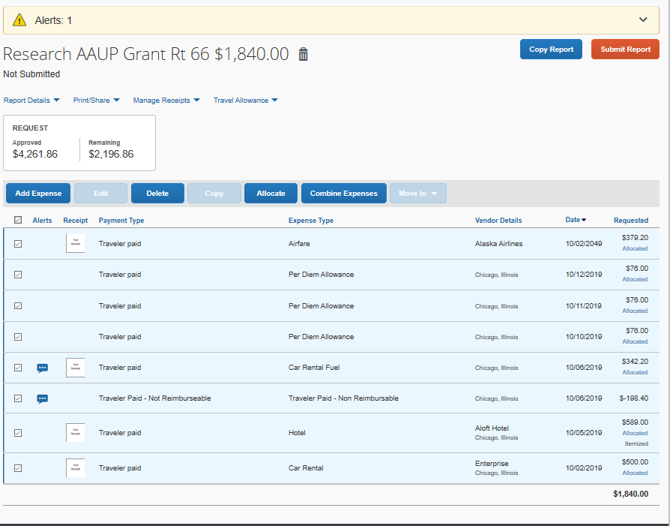
Allocating Expenses
Disregard
Can allocate individual expenses or groups
Click box under Add Expense to select all expenses
Allocate button will appear
Click it to open allocation screen

Slide 14
Allocating Expenses
Can allocate by Percent or Amount
Can add new indexes or edit existing
Click on the index to modify, then click Edit
Edit Allocation screen will open
Click save at the bottom (when all adjustments complete)

Slide 15
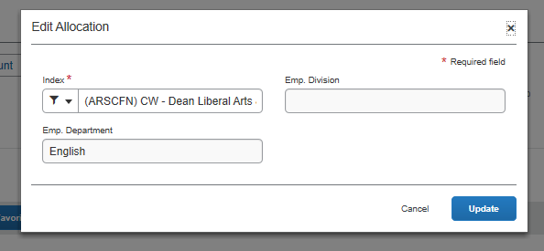
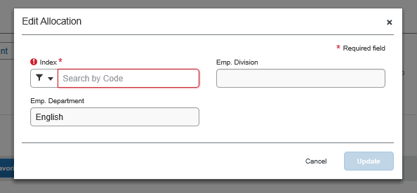
Allocating Expenses
Edit Allocation screen
Default Banner Index will populate
Delete and enter new Banner Index
If unsure of index, please contact Travel Office or funding department
Click Update when correct Banner Index is selected

Slide 16
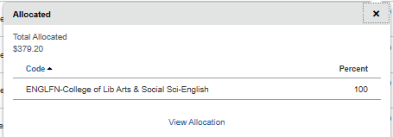
Allocating Expenses
Individual expenses can be allocated
Click Allocated under the dollar amount of the expense
Allocation summary will open, click View Allocation to reallocate
Reallocate by percentage or amount, click Save
All expenses must be allocated
Will have Allocated under dollar amount of expense

Slide 17
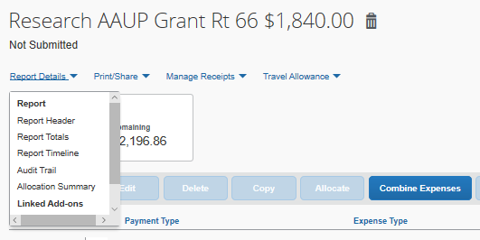
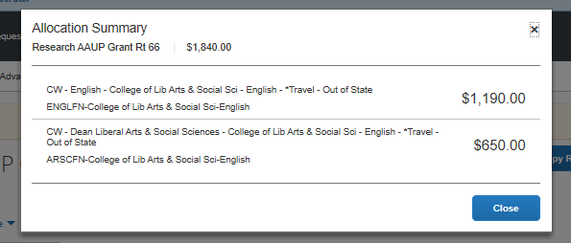
Allocating Expenses
Verify allocation summary in Report Details > Allocation Summary
Easily see how much money is allocated to each index

Slide 18
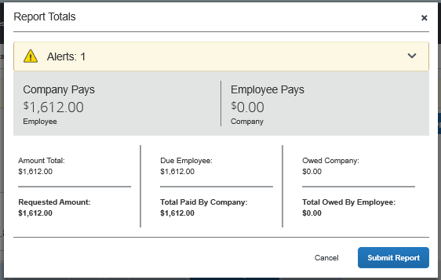
Submitting Expenses
Expense reports must be submitted by traveler
Alerts must be satisfied before submitting
Red exclamation marks are a hard stop, must be fixed before submitting
Yellow triangles are a soft stop, may be bypassed if alert does not apply to traveler
Click Submit Report Twice

Slide 19
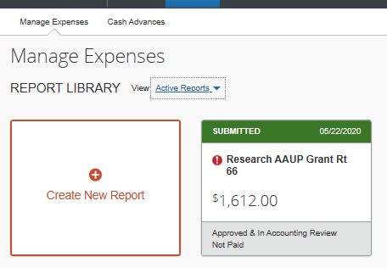
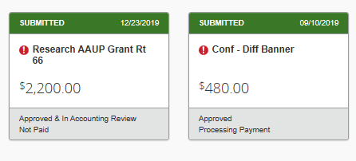
Submitting Expenses
All successfully submitted expense reports will show in Report Library
Report status visible on each expense report
Approved & In Accounting Review: approved by supervisor/budget manager
Approved: approved by Travel Office

Slide 20
Request Interface
Approved amt
Request interface remains unchanged
Approved means approved to travel, does not mean all expenses submitted are allowable
Please be advised that the actual, true “approved” amount is the Total amount
Review comments for details regarding allowable expenses
Disregard

Slide 21
Travel Help
Please refer to the Travel webpage or call the Travel Office (x22580) for policy-related questions
Please email the Travel Office (CCSUTravelHelpdesk@ccsu.edu) with screenshots of the error message and we will assist via email, telephone, WebEx or Microsoft Teams

