Slide 1
Common Chart of Accounts
April 24, 2018

Slide 2
Common COA Committee
Formed July 2016
Comprised of 7 members
Shirley Audet, Controller – ECSU
Brian Wood, Director of Accounting - CCSU
Alessandra Lundberg, Director of Finance & Administration – QVCC
Gayle O’Neill, Director of Finance & Administrative Services – TRCC
Chris Forster, Controller – CSCU SO
Bhavini Mistri, Sr. Information Systems Development Mgr. – CSCU SO
Brenda Whalen, Chief Enterprise Project Mgr. – CSCU SO

Slide 3
Common COA Committee Charge…
Develop common COA combining current elements of the CSU and CCC charts to facilitate detailed and consolidated reporting across CSCU.
Design Common COA employing best practices as defined by NACUBO, GASB & the Number of Funds Principals to meet IPEDS, NEASC, GASB, NCAA (D 1,2 & 3) & IDC Proposal requirements.
Define/Create a Centralized Reporting Repository
Provide ability to report horizontally and vertically by University/College, CCC/CSU and CSCU
Provide ability to produce individual and consolidated Financial Statements (SRECNP, Statement of Net Position & Cash Flow)

Slide 4
COA Components
Behind the Scene
Banner Finance Users
COA Code
Fund Types
Fund Codes
Account Types
Organization Codes
Program Codes
Index Codes
Account Codes

Slide 5
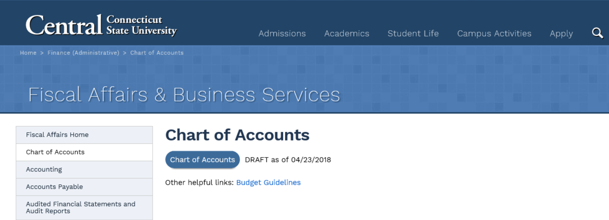
COA Reference Information
http://www.ccsu.edu/fiscalaffairs/accountsChart.html

Slide 6
Account Code Translation
New Account Code | New Account Code Descriptions | Old Account Code | Old Account Code Descriptions | Data Definitions
 | Professional Services | New
701000 | Personnel Advertising | 721100 | Personnel Advertising | Advertising for employment opportunities
701001 | Advertising | 721105 | Advertising | All advertising with the exception of employment related advertising.
 | Professional Services - Other | New
701300 | Legal Services | 721130 | Legal Services | All legal professional service fees
701301 | Medical Services | 721135 | Medical Service | All health contract professional service fees
701302 | Other Professional Services | 721145 | Professional Services-Other | Payments for services by a professional who performs the service.
 | Other Services | New
701400 | Athletes & Entertainment Services | 721146 | Athletes & Entertainers Appearances | Charges for Professional athletes and entertainment services
701401 | Athletic Event Services | 721147 | Athletic Event Services | Fees paid to support specialized services for athletic events. E.g. Track and field timing services
701402 | Athletic Officiating Services | 721148 | Athletic Officiating Services | Charges for athletic officiating services
701403 | Other Services | 72312 | Credit Card Convenience Fees | Oher services where no employee-employer relationship exists
701403 | Other Services | 721140 | Non Professional Services-Other | Oher services where no employee-employer relationship exists
701404 | Honoraria | 721120 | Honoraria and Lecturer | General Honoraria. E.g. Graduation speakers, guest speakers, etc.
 | Dues, Licenses, & Subscriptions | New
701500 | Dues & Memberships | 722100 | Dues and Memberships | Charges for associations, dues and memberships
701501 | Subscriptions - Non Educational | 722105 | Subscriptions | Periodical and magazine subscriptions related to the agency's functions.
701502 | Licenses | 722110 | Licenses | Payments for licenses
 | Educational Supplies | New
702200 | Educational Supplies | 713135 | Educational Supplies | Supplies used for educational purposes. This includes consumables used in teaching and classrooms as well as the cost of any ticketed events required by a class and paid for by the institution.

Slide 7
Additional Questions & Comments?

