Slide 1
An Equity-Focused Search at Central Connecticut State University Presented by the Office of Regulatory Affairs

Slide 2
Back to Basics: Connection to the Bigger Picture
Employment actions, including all aspects of the search process, are guided by Affirmative Action/Equal Opportunity and Fair hiring practices, as well as adherence to various collective bargaining agreements.
To align the search process with our equity pillars, the process includes oversight to ensure that equal employment opportunity and equity are at the forefront of this work.

Slide 3
Confidentiality
Critical to maintaining the success of the search process
Protects the integrity of the committee
Applies for All members of the search process (e.g., HR, Talent Acquisition, Hiring Manager, Search Committee, etc.)
Be mindful of locale and medium
Ask yourself: Is this or should it be a private conversation?

Slide 4
Conflicts of Interest
Defined as the pre-existing relationship between a member of the search process and a candidate
Must be evaluated to determine proper course of action
Regulated by State of Connecticut policies including the Nepotism in Employment Policy and Code of Ethics

Slide 5
What Do I Do if I have a conflict?
Connect with your Recruiter to discuss the possibility of a conflict of interest existing.
The Recruiter will advise Office of Regulatory Affairs of the relationship and we will work together to coordinate an effective solution.
Solutions may include recusal from the evaluation and/or interview of the particular candidate(s) allowing you to still participate but defers to the committee for the final result, or recusal from this search in its entirety.

Slide 6
Bias in Interviewing Training
Online training through NEOGOV
Designed to encourage conversations around our implicit biases early in the search process to support ongoing dialogues
Embodies self/peer accountability as the search process takes shape
What are some biases that you know of?

Slide 7
What does service on the committee look like?
Committee Member
Maintains confidentiality
Promotes the job when practicable
Attends committee meetings and participates
Evaluates objectively
Goal: Present the best qualified candidates forward
Committee Chair
Leads the committee logistically
Oversees the search process
Coordinates with HR Recruitment/ORA
Ensures civility and facilitation of the process
Goal: Steward the committee to success

Slide 8

Interview Questions 101
Think about the themes of the position, e.g. interpersonal skills, technology skills, etc.
Committees should consult with the hiring manager of the questions they would like asked.
Committees are empowered to review the questions identifying areas for more clarity/campus specific needs (e.g., experience with a specific population, etc.)
Good questions are:
Quantifiable
Balanced between “technical” and behavioral
Allow for candidates to highlight their experience and transferable skills

Slide 9
Once applications are released…
Committee members will independently review all candidates
Reviews are maintained within the Search Packet
If conflicts of interest are present, identified members would recuse themselves from the review of this candidate
Things happening during the review:
Verification of the answers provided
Assessment of the candidate based on the Minimum Requirements, Preferred Requirements, and any other relevant information

Slide 10
Applicants are evaluated on…
The Minimum and Preferred Qualifications of the Job Posting
Qualifications are derived from the Job Description which includes all relevant information
Job Descriptions are created by a variety of factors including the Collective Bargaining Agreements (CBAs)

Slide 11
What not to do in the applicant review…
Use outside information about the candidate(s)
Do not make notes about rankings of candidates (e.g., top tier, second, exceptional, outstanding, etc.)
Move forward candidates who do not have the Minimum Requirements (e.g., job requires a Master’s Degree but the candidate has a Bachelor’s Degree)
Disqualify candidates because of past experiences, knowledge, or context
Google Search the candidates/view the LinkedIn profiles of the candidates
Whenever you think about making a comparison to other candidates or use subjective language, STOP!

Slide 12

What exactly am I evaluating?

Slide 13
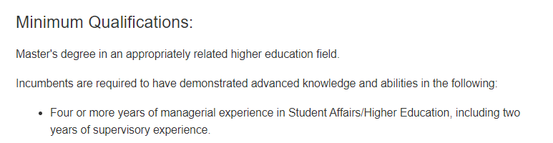
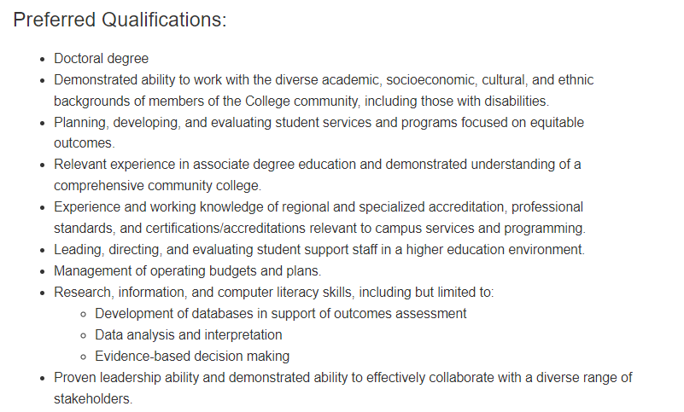
Example of Qualifications
Preferred Qualifications are determined by the Hiring Manager

Slide 14
If you find incongruencies…
Confirm the incongruency using the candidate materials (e.g., resume, cover letter)
Enter the correct answer to confirm the information was verified by the committee
Note in the committee comments section what qualifications were lacking
Be sure to bring this up during the committee review to determine who is moving forward

Slide 15
Everyone did their reviews, now what?
The committee reconvenes and assesses the candidates together identifying:
Candidates that do not meet the Minimum Requirements
Candidates that meet some of the Minimum Requirements
Candidates that meet the Minimum Requirements
Candidates that meet some/all of the Preferred Qualifications
These assessments are translated into the Applicant Screening Tool

Slide 16
What is the Applicant Screening Tool?
The Applicant Screening Tool will be sent to you from ORA
The applicant list will be provided to the committee by HR.
Copy and paste the names of the applicants.
Each column to be evaluated is populated with a drop-down option (Yes/No)

Slide 17

Are you confused yet?
This Photo by Unknown Author is licensed under CC BY

Slide 18
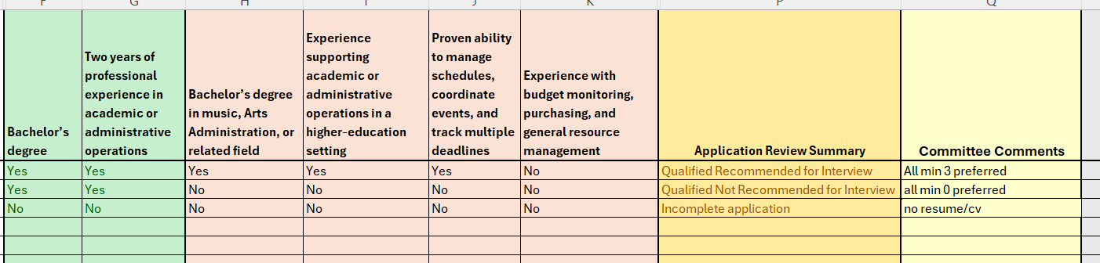
The goal is to have an Applicant Screening Tool that looks like this
Minimum Qualifications
Preferred Qualifications

Slide 19
Determining Who Interviews
Important to make sure that candidates who meet the minimum requirements for the job are at a minimum indicated as “Qualified – No Interview (based on Preferred Qualifications”
Committees can determine what qualifications move forward
Minimums AND 3+ Preferred Qualifications
Minimums AND ALL Preferred Qualifications
Just Minimums
A more competitive pool may require the committee to draw some clearer, harder lines

Slide 20
Do they meet the Minimums?
Job 1 (Assistant Professor)
Requires a PhD in Biology
Four years of teaching (96+ credits) or two years of teaching experience (48+ credits) with four or more years of relevant professional experience
Candidate has a PhD in Biology and has three years of adjunct teaching (total 30 credits)

Slide 21
Do they meet the Minimums?
Job 2 (Administrative Services Assistant)
Requires an Bachelor’s Degree or combination of education, training, and experience
Experience working in a cashier, finance, financial aid, or similar financial and/or business office
Candidate has a high school diploma and 15 years of experience as an Assistant Bursar (Business Office)

Slide 22

Interview Best Practices
Providing candidates the questions throughout the interview (e.g., pasting into the chat, providing them in paper form for in-person interviews, etc.)
Utilizing Teams and other video conferencing platforms to remove barriers to accessing interviews
Evaluating the performance of the interviews and establishing the strengths and weaknesses directly after the interview (post debrief)
Recommended that the committee moves forward 3-5 candidates to second interviews (if applicable)

Slide 23
Writing Strengths & Weaknesses
GOAL: Have someone as an external reviewer be able to understand how the committee came to the conclusion they did
Questions to ask:
Is what I am writing specific enough?
Does it include examples?
Is what I am evaluating related to the essential functions of the job?
Major barriers are time, bias, and fear of language

Slide 24
What Would You Improve?
Strengths
Weaknesses
Provided examples about grant involvement/projects.
Candidate understood what diversity meant.
Candidate mentioned their involvement in the community.
Candidate is the current person in the position.
Candidate did not answer Questions 2, 4, and 7.
Candidate did not talk about the mission of the college.
Candidate did not discuss budget amounts.
Candidate stuttered during Question 1.

Slide 25
Position: Enrollment Management Specialist
Strengths
Weaknesses
Customer Service/De-Escalation: Candidate discussed their 10+ years of experience supporting a OneStop operations for admissions, enrollment, and financial aid. Specifically, the candidate discussed an example where the student’s transcript was not evaluated despite receiving confirmation from the Transcript Evaluator. Candidate discussed how they printed out the documentation for the student, CC’d them on their email to the TE, and walked the student to their Advisor to start the override waiver process.
Enrollment Management: Candidate described their experience creating a streamlined system of processing enrollment/program change forms citing platforms like Hyland OnBase and Ellucian Banner. Candidate mentioned their knowledge of catalog information and why it is important to always reference the year of the catalog as minor changes can occur from academic year to academic year (e.g., the example they gave was with General Studies citing four changes between two degrees in a 2-year time span).
Equity-Forward Mindset: While candidate discussed their commitment to equity and supporting students where they are, they did not mention concrete examples or situations where they needed to think with an equity-focus at the forefront.
Data Management: Candidate discussed that often times during their day-to-day, they prioritize the customer-focused work first and that sometimes, they can miss the mark in ensuring accurate notes, documentation, etc., however, the candidate discussed ways that they are actively improving this including using time blocking to support the administrative tasks.

Slide 26
What is ORA Looking For in Our Review?
Specifics: Examples, experiences, and details that support the evaluation (e.g., including examples of advising practices for a strength of understanding advising)
Objectivity: No use of personal identities, protected classes, subjective language, etc., in the evaluation (e.g., separation of skill and the person when identifying strengths and weaknesses)
Consistency: Consistent evaluation across all candidates during the interview phase (e.g., all candidates being evaluated for conflict resolution, budget management, and project management)

Slide 27
Second-Round Interviews
Normally conducted within two weeks of the first-round interviews
Facilitated by the Direct Supervisor and Hiring Manager
ORA recommends that second-round interview questions are reviewed, but it is not required
Final interviews are conducted, strengths/weaknesses are evaluated, and ORA will review
Final approval is requested by the hiring manager once the recommended hire is reviewed

Slide 28
Summing It Up!
Be thoughtful, objective, and specific.
Consider the biases you have and hold yourself accountable, as well as your peers.
Remain consistent in your practices. Consider where you apply them (e.g., assessment, evaluation, and interviews)
Ask yourself “Am I being specific enough for someone to understand if they did not participate in the search?”
When in doubt call ORA directly and ask for help.

Slide 29

Questions?

