Slide 1
The Mulligan Concept
Clinical Application of Mulligan’s MWM and Taping Techniques of the Ankle
Julie Paolino MS PT ATC MCTA
Robert Huyler DPT CMP CIDN

Slide 2
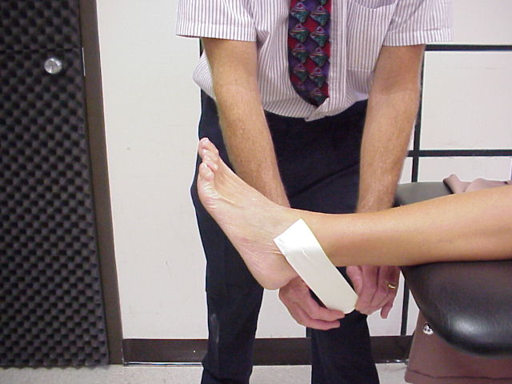
Inversion sprains- tape

Slide 3
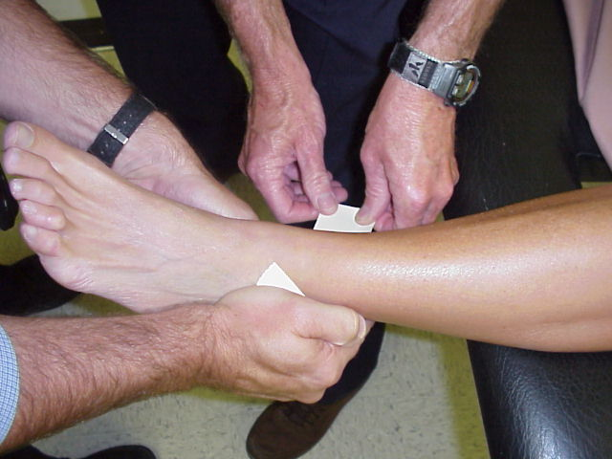
Inversion sprains- tape

Slide 4
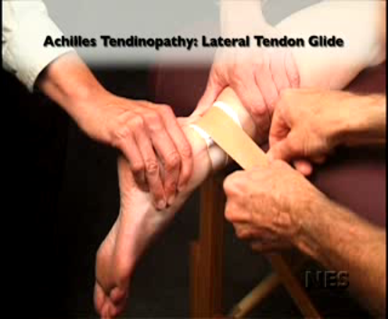

Slide 5
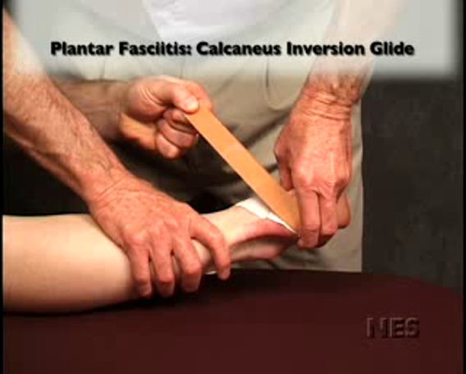

Slide 6
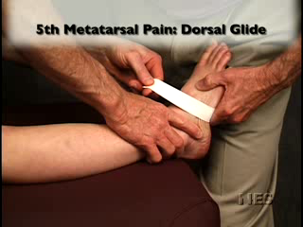

Slide 7
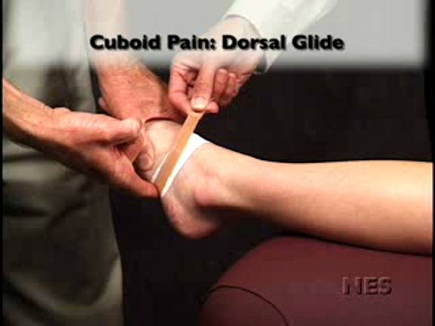

Slide 8
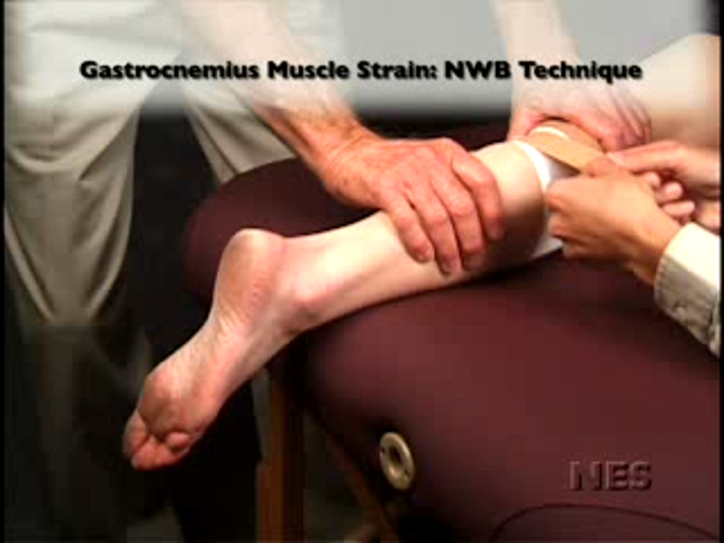

Slide 9
