Slide 1
The Mulligan Concept
Clinical Application of Mulligan’s MWM and Taping Techniques of the Ankle
Julie Paolino MS PT ATC MCTA
Robert Huyler DPT CMP CIDN

Slide 2
LEARNING OBJECTIVES
1.Describe the principles and indications of Mulligan’s Mobilization with Movement as applied to the ankle joint.
2.Demonstrate proper hand placement , patient positioning , and movement patterns for ankle MWM techniques
3.Integrate ankle MWM into a comprehensive rehabilitation program to improve dorsiflexion, function, and return-to-play outcomes

Slide 3
Conflict of interest
To comply with professional board and accreditation standards, I declare that I do have a financial interest in products or services discussed in my presentation.

Slide 4
What is MWM?
“MWM” mobilization with movement Application of a passive accessory glide (force) followed by active or passive physiological movement; typically done in weight bearing.

Slide 5
MWM principles
Identify painful &/or restricted movement
Mobilize in the direction that turns off pain
Use minimum force necessary
Sustain glide without restricting movement
Perform sufficient repetitions
Apply overpressure
Teach self-MWMs
Tape to sustain positional corrections
Notes:
6:40

Slide 6
Mulligan’s theoretical model
Minor articular “positional faults” occur due to trauma, muscle imbalances, and/or degenerative changes.
MWM’s correct positional faults allowing pain-free movement or function to occur.
Notes:
4:10

Slide 7
Lateral Ankle Sprains
Textbooks focus on anterior talofibular ligaments and calcaneal fibular ligaments
Treatment focused on ligaments secondary to objective findings of pain with passive plantarflexion and inversion
MULLIGAN FEELS THIS IS WRONG!
Notes:
00:52

Slide 8
Mulligan Theory
Mulligan feels lateral ankle sprain is a joint problem related to fibula and tibia positioning and NOT extra-articular problem associated with ATFL
Notes:
1:50

Slide 9
Mulligan Theory
Mulligan Theory: Fibula positioned anteriorly relative to tibia (“Positional Fault”)
When fibula repositioned dorsally and cranially passive PF and Inv is PAINFREE
Notes:
2:15

Slide 10
A.T.F. Ligament with inversion
Tension in ATFL pulls fib. forward
Notes:
6:00

Slide 11
Lateral Ankle Sprains
Objective Test: PAIN with passive Plantarflexion(PF) and Inversion (INV)
Mulligan Theory: Fibula positioned anteriorly relative to tibia (“Positional Fault”) when repositioned passive PF and Inv is PAINFREE
Notes:
1:30

Slide 12
Lateral Ankle Injuries
In lateral ankle injuries prime injury occurs between tibia and fibula
Notes:
7:17

Slide 13
Taping
Traditional taping restricts motion secondary to DF/EV foot
Traditional taping does not allow for PF/INV and unable to move ankle and decrease swelling
Traditional taping “useless”
Notes:
8:50

Slide 14
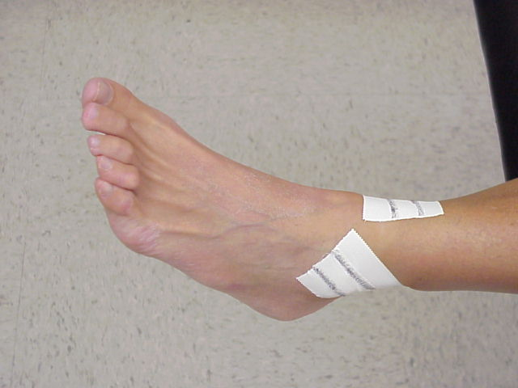
Taping
Mulligan Taping for Acute Lateral Ankle Sprains
MWM IMMEDIATELY!
TAPE IMMEDIATELY!
2nd strip of tape
Notes:
11:24

Slide 15
Ankle sprain - distal fibula MWM Reference
Kavanagh J. (1999) Is there a positional fault at the tibiofibular joint in patients with acute or chronic ankle sprains compared to normals. Manual Therapy, 4(1), 19-24.
Results indicated a significantly greater amount of movement per unit force after ankle sprains.
Notes:
3:55

Slide 16
Ankle sprain - distal fibula Mwm Reference
Hubbard T, Hertel J, Sherbondy P. (2006) Fibular position in individuals with self-reported chronic ankle instability. Journal of Orthopedic and Sports Physical Therapy, 36(1) 3-9.
Conclusion: Fibula positioned more anteriorly in relation to tibia in CAI than control group
Notes:
4:36

Slide 17
Ankle sprain - distal fibula MWM Reference
Hubbard T., Hertel J. (2008). Anterior positional fault of the fibula after subacute lateral ankle sprain. Manual Therapy, 13(1): 63-67.
Results: 82% (n=11) of ankle sprains had anteriorly positioned fibula as well as direct correlation between amount of swelling and anterior position
Notes:
5:08

Slide 18
Inversion Ankle Sprain reference
Moiler K.,Hall T., Robinson K. (2006). The Role of Fibula tape in the prevention of ankle injury in basketball: a pilot study. JOSPT, Sept.
Results: 443 basketball exposures resulted in 11 ankle injuries. All injuries occurred in subjects with a history of previous ankle sprains. Significantly less ankle injuries were sustained by members of the fibula repositioning taping (FRT) condition compared to the control group
Conclusion: study provided preliminary data regarding the prophylactic effects of FRT on ankle injuries in basketball players
Notes:
7:35

