Slide 1

Core-CT
Student Worker Self Service
Time and Attendance
Training
Rev. 07/31/13

Slide 2
Core-CT Timesheet Entry
Bi-weekly timesheets which include all hours must be submitted by the close of business every other Thursday (Pay Day Thursday).
Hours must be entered in increments of .25 (i.e. 5.25 hours, 5.50 hours, 5.75 hours) and can be submitted at the end of your shift each day.
  Your supervisor must approve your timesheet by the close of business on the next day (Friday following Pay Day).
Instructions follow on how to use the Core-CT self Service tool.

Slide 3
How to Log In to Core-CT
This is a web-based system that can be accessed at: http://www.core-ct.state.ct.us
All student workers are sent an email containing their Core-CT Username and temporary Password.
Your Username is your 6-digit State of Connecticut Employee ID that is listed on your biweekly paycheck advice.

Slide 4
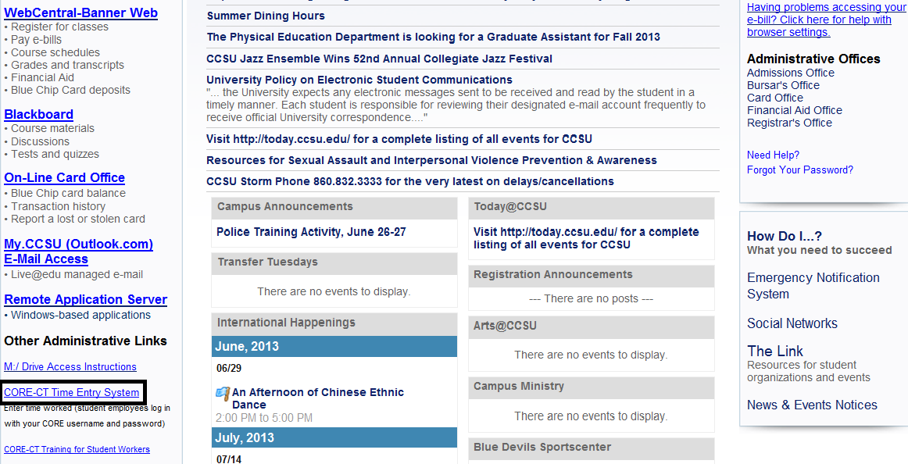
1. Navigate to the CCSU home page at www.ccsu.edu. Point to CentralPipeline, then click on CentralPipeline for Students (or click on Current Students). Scroll to the bottom of the page and click on CORE-CT Time Entry System.

Slide 5
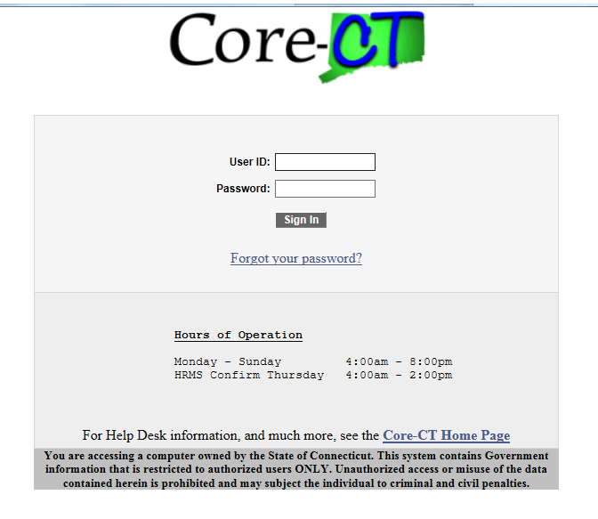
2. Enter User ID and temporary Password that were emailed to you from Human Resources then click on Sign In:

Slide 6
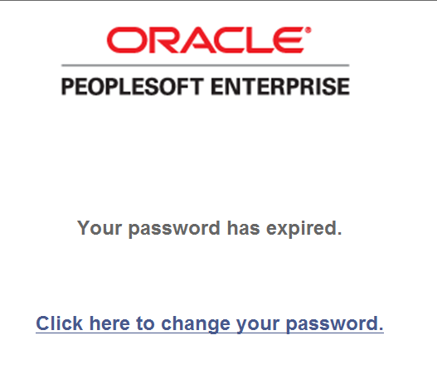
3. You will be prompted to change your password. Select “Click here to change your password.”

Slide 7
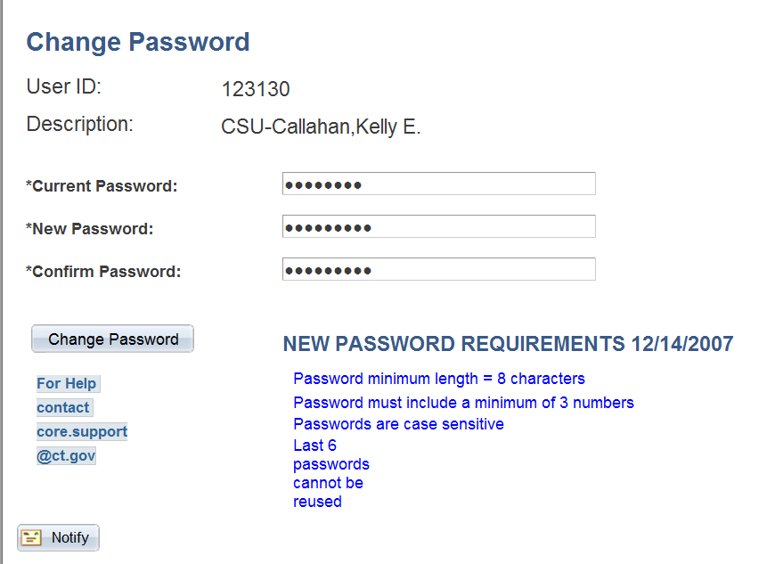
4. The Change Password page displays. Enter the temporary password (that was emailed to you) in the Current Password field. Enter a new password and confirm it. Click the Change Password button. ( See new password requirements below).
999999
CSU-Smith, Sue

Slide 8
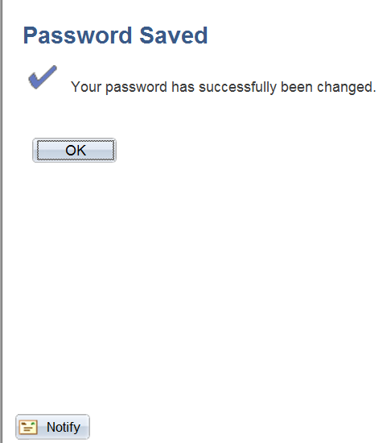
5. You will receive a confirmation screen stating that your Password has been Saved. Click OK. (You will need to remember this password and use it each time you login to Core-CT.)

Slide 9
How to Set Up the Forgotten Password Help
IMPORTANT - The first time you login to Core-CT, you must set up the forgotten password help. You will need this in case you forget your password in the future.

Slide 10
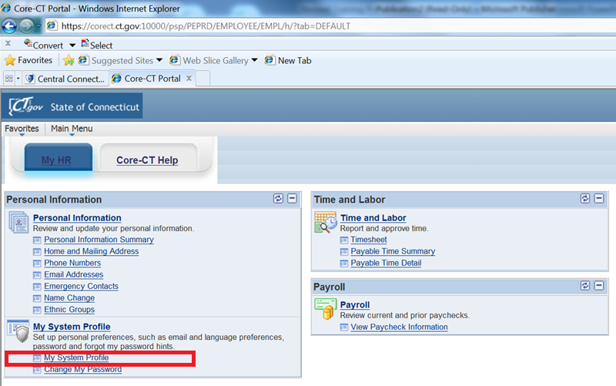
1. To set up password reset process, login to CORE-CT. Click the My System Profile link.

Slide 11
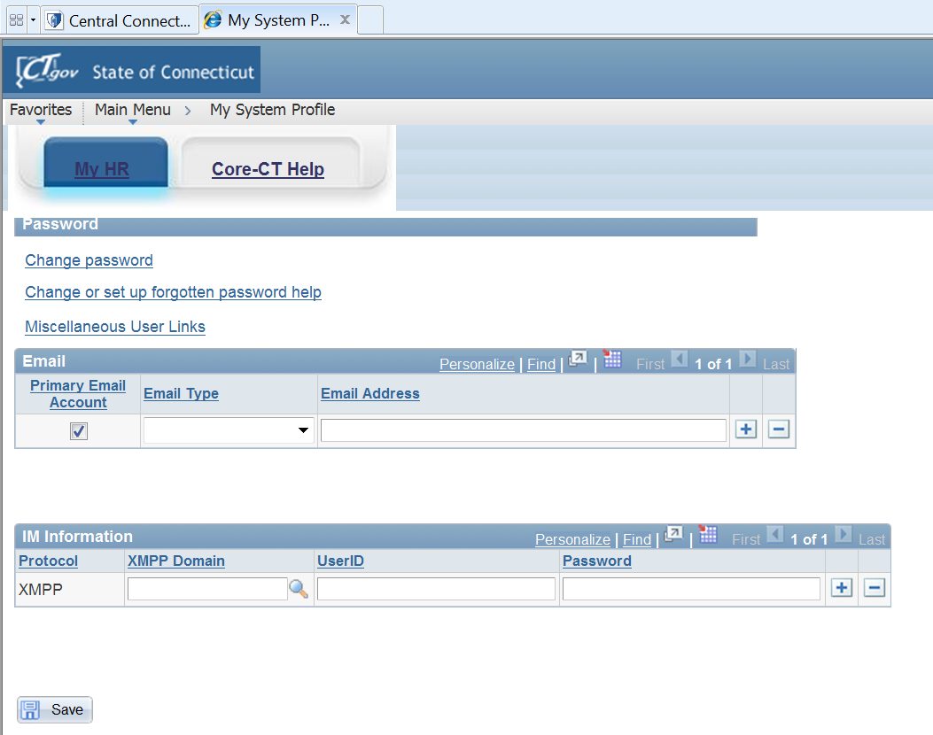
2. Verify that a valid e-mail address is entered in the e-mail box. Make any corrections if necessary and click Save. If you forget your password, it will be emailed to this email address.

Slide 12
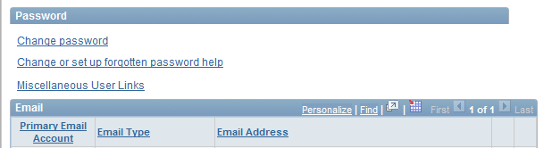
3. Click the Change or set up forgotten password help link.

Slide 13
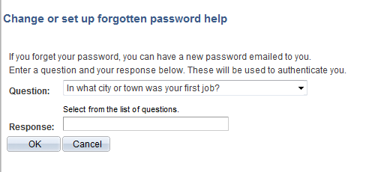
4. Click the Question drop down list and select a question to answer.

Slide 14
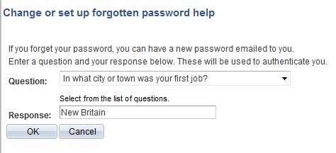
5. Enter a Response (not case sensitive). Click the OK button. You have now completed setting up the forgotten password help process.

Slide 15
How to Use the Forgotten Password Help
You need to submit your timesheet and you forgot your password.
What should you do?

Slide 16
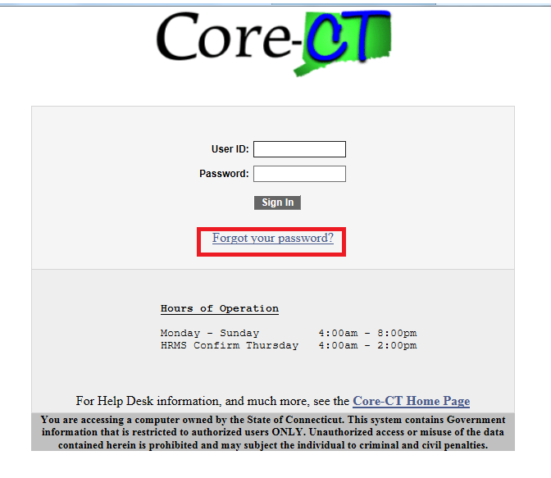
1. To use the password reset feature because you have forgotten your password, go to the Core-CT login page. Click the Forgot Your Password? link on the sign-in page.

Slide 17
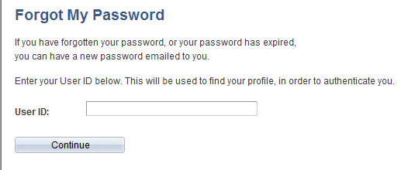
2. The Forgot My Password page displays. Enter your 6-digit User ID. Click the Continue button.
999999

Slide 18
3. Enter the same Response as the one entered on the My System Profile that you set up (not case sensitive). Click OK.

Slide 19
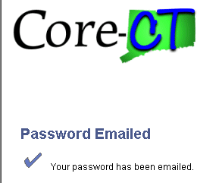
4. The following message displays with notification that a temporary password has been emailed to you at the email address that CoreCT has on file for you.
5. Check your email account for an email from corect@po.state.ct.us. This email will contain your temporary password.

Slide 20
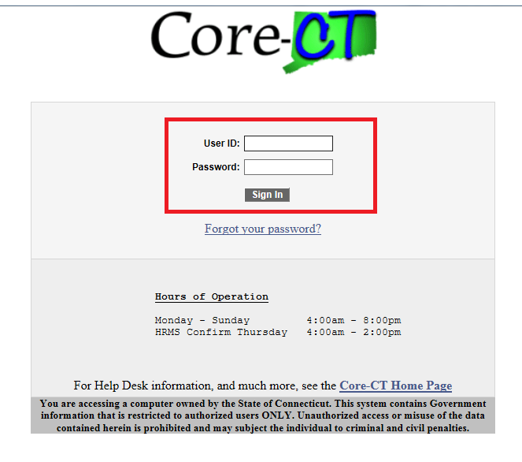
6. Enter your User ID and the temporary system generated password sent in the email. Click the Sign In button.

Slide 21
How to Enter Your Timesheet in Core-CT
Report all time worked on your Timesheet in increments of .25. You may enter hours worked at the end of your shift each day.
It is your responsibility to enter all hours worked on your timesheet by 8 pm on the last day of the pay period and to make sure that your supervisor approves it by the close of business on the next day (Friday following pay day).
If you don’t submit a timesheet and make sure it’s approved, you will not get a paycheck.

Slide 22
Important things to remember …
Time must be submitted in a minimum of .25 hour increments.
It is STRONGLY RECOMMENDED that you submit your time on a daily basis.
Before a timesheet can be approved it must be processed by the system overnight.
If a change is made to the timesheet it must be processed overnight again before it can be approved.
If you make a change to your timesheet after your supervisor has already approved your timesheet, you must inform your supervisor that a change has been made.

Slide 23
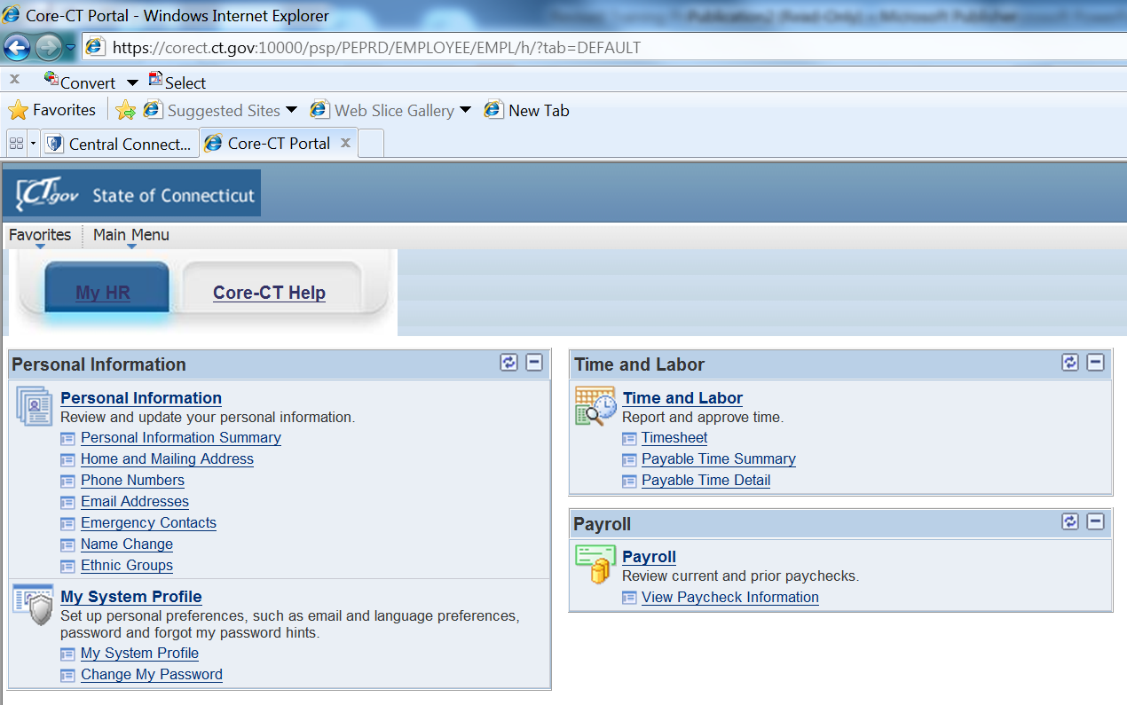
1. Login to CORE-CT (see previous slides if necessary). The Home page displays. Click on Timesheet under the Time and Labor Menu.

Slide 24
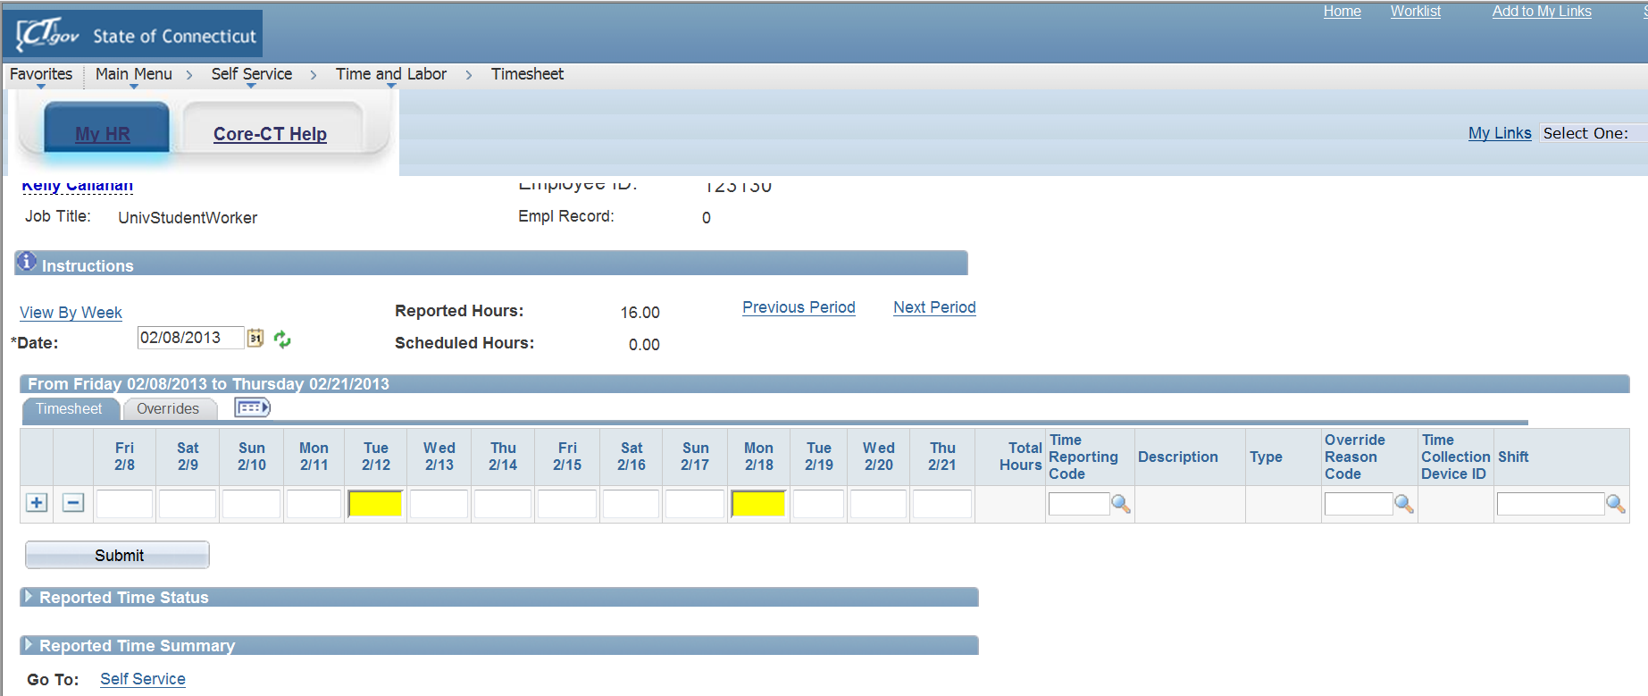
2. A blank timesheet displays for the entire pay period. If the correct pay period is not displayed, click on the calendar icon next to the date field and select the correct date for the first day of the pay period (the Friday after Pay Day).

Slide 25
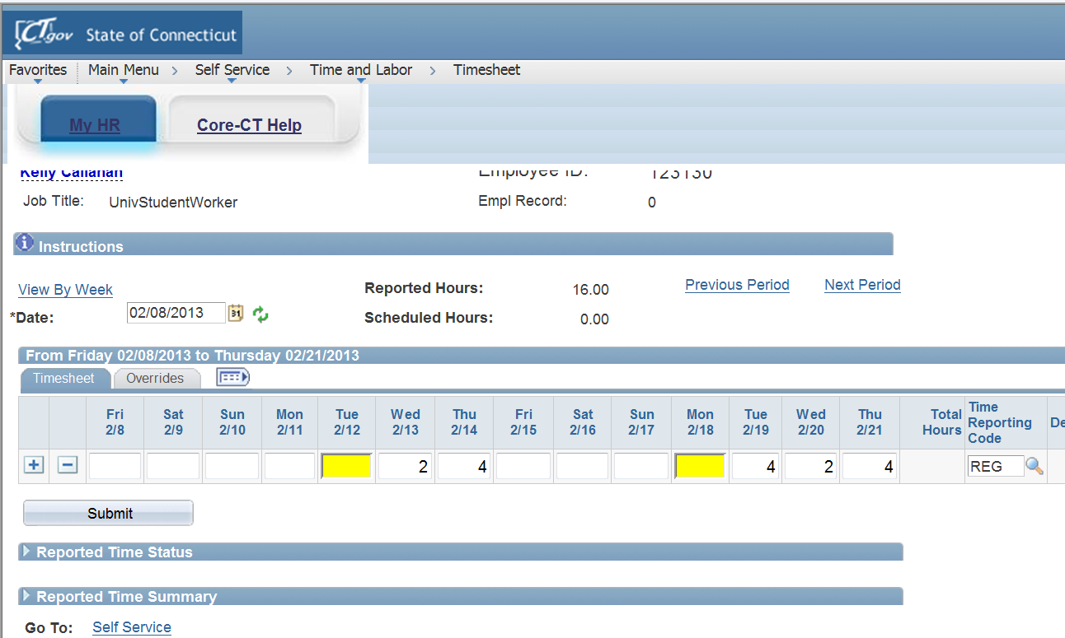
3. Enter the number of hours worked in the box under the appropriate date(s) you worked during the pay period. Under Time Reporting Code enter “REG” into the box. Review your hours to make sure what you have entered is correct. Make fixes if necessary. Click Submit.

Slide 26
How to View Payable Time
Once you have submitted your timesheet and it has processed overnight, you may view your hours and the status of your timesheet through the Payable Time Detail link.
This is how you will be able to see if your supervisor has approved your timesheet.

Slide 27
1. Login to CORE-CT (see previous slides if necessary). The Home page displays. Click on Payable Time Detail under the Time and Labor Menu.

Slide 28
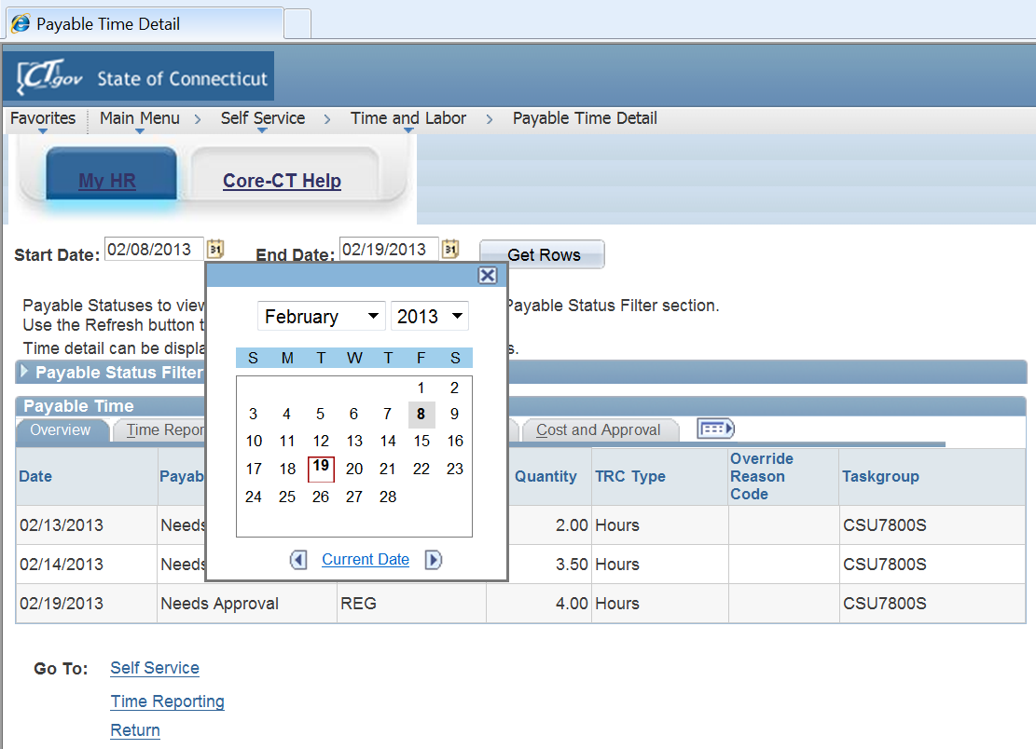
2. Click on the calendar next to the Start Date and select the first day of the pay period (Friday after Pay Day). Click on the calendar next to the End Date and select the last day of the pay period (Pay Day Thursday). Then click the Get Rows button.
Notes:
Enter Start Date and End Date of current pay period.

Slide 29
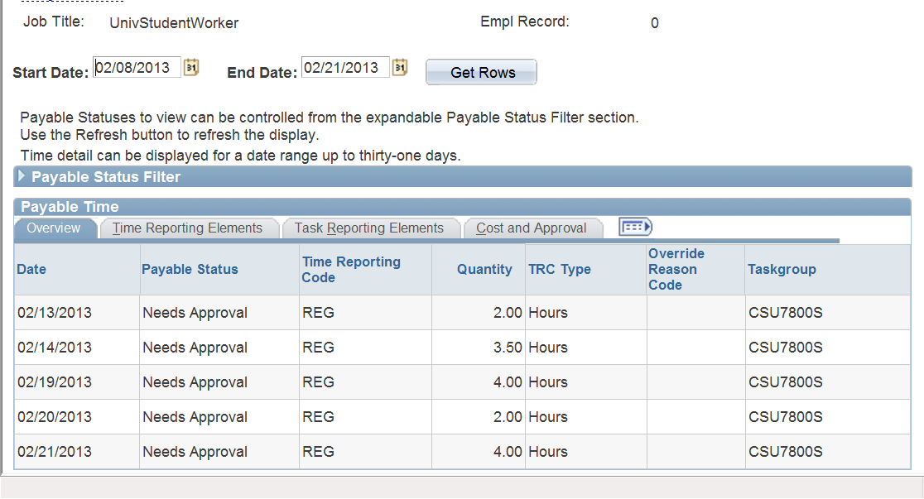
3. Verify that all hours submitted are listed on the Payable Time Detail. A status of “Needs Approval” indicates your supervisor has not yet approved your timesheet. Once the timesheet has been approved the status should reflect “Approved – Goes to Payroll”.

Slide 30
Overall Reminders about Core-CT Self Service
You must submit all hours worked on a timesheet every pay period by 8 pm on Pay Day (Thursday).
Report all time worked on your Timesheet in increments of .25. You may enter hours worked at the end of your shift each day.
It is your responsibility to enter all hours worked on your timesheet by 8 pm on the last day of the pay period and to make sure that your supervisor approves it by the close of business on the next day (Friday following pay day).
Set a recurring reminder on your Outlook calendar for every other Thursday (Pay Day) to submit your timesheet.
Add the Core-CT log-in page to your favorites on your desktop.
Core-CT shuts down Monday through Sunday at 8 pm.
Core-CT is not available after 2 p.m. every other Thursday (not Pay Day) due to payroll processing.

Slide 31
For Assistance Please Call:
Doreen Revoir x22503
Alyssa Miano x22501

